Slide 1
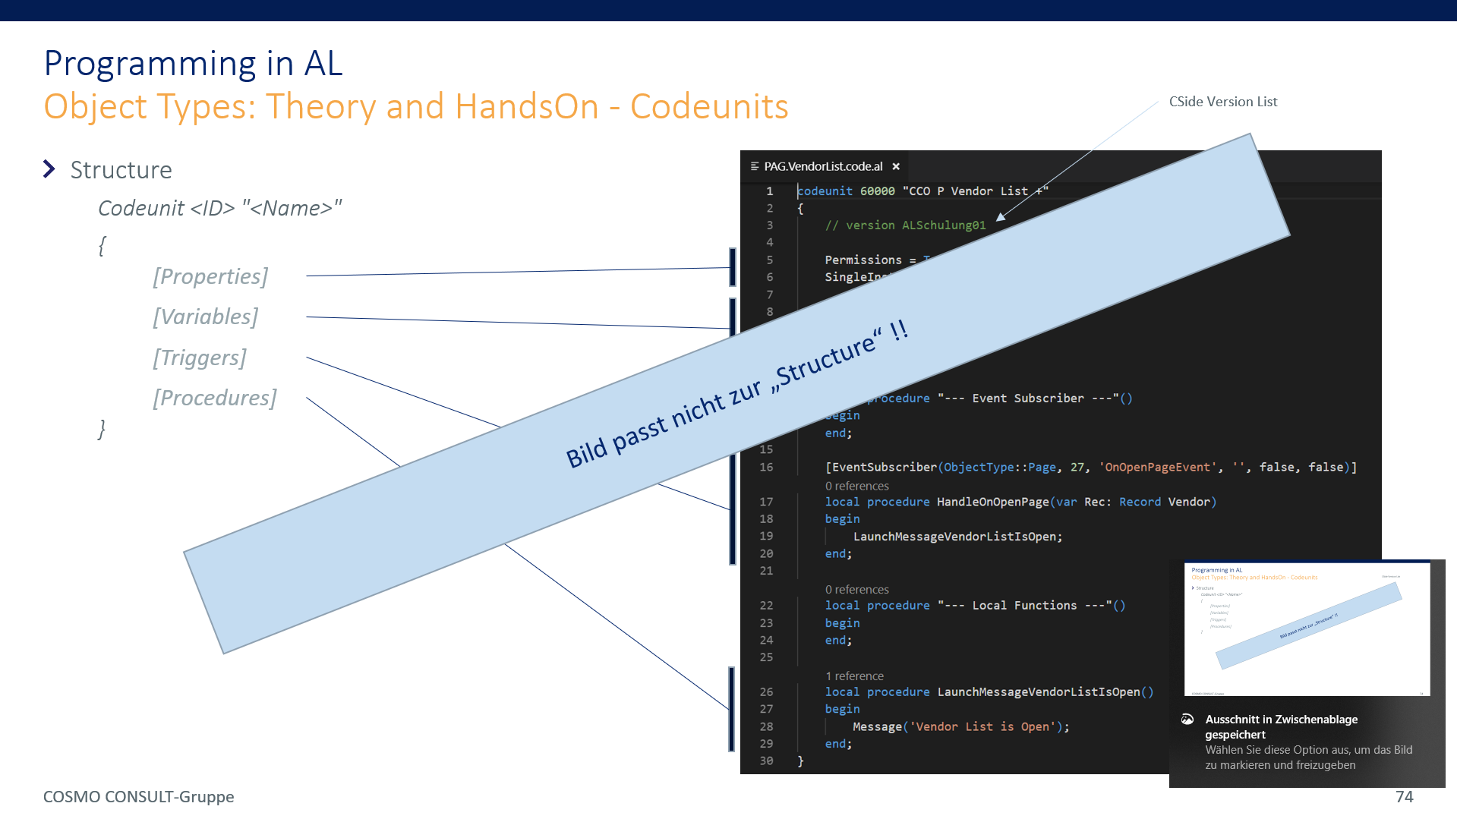
ToDos4MPro
Ausgeblendete Folien entfernen, wenn möglich
Ole Verbesserungen einbauen
Kapiteltitelfolien aktualisieren
SubKapitelfolien generieren
Agendenfolien durch aktuelle Screenshots der Kapitelfolien ergänzen
Folie 74 verbessern
Evtl.: alle Examples / Excercises als Projekte zur Verfügung stellen
Function Overload zumindest in den „was fehlt“ erwähnen

Slide 2

Microsoft AL
06-AL-Basics

Slide 3
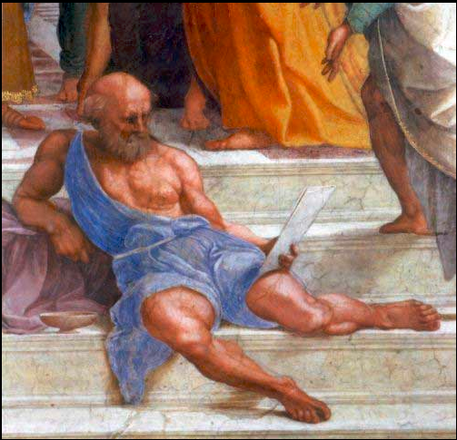
Core Statements on the subject of Programming AL What the wise man says
Programming AL is almost like programming C/Side TXT files
Use MS Txt2AL Converter whenever you‘re helpless
What changes is the object structure: Fobs in Object Designer → AL (txt) Files in File System
It is crucial to setup a normalized file structure to
become more efficient
give „everyone“ the chance to „participate a development“ without the need of lengthy project individual introductions
It is lots more about getting familiar with guidelines and „doings“ than learning to code AL
if “actions are too cumbersome”, we will think about suitable tool-assistance

Slide 4
Literature / further Reading & Watching
VS Code
https://code.visualstudio.com/docs/getstarted/introvideos
https://jpearson.blog/2019/01/31/vs-code-powershell-git-5-things/
https://code.visualstudio.com/docs/getstarted/tips-and-tricks: multi cursor editing …
…

Slide 5
Agenda
1
Basis
2
Boundary Conditions / Setups: HowTo handle a Project - a Repetition
3
Programming in AL
4
Miscellaneous
5
Q & A

Slide 6
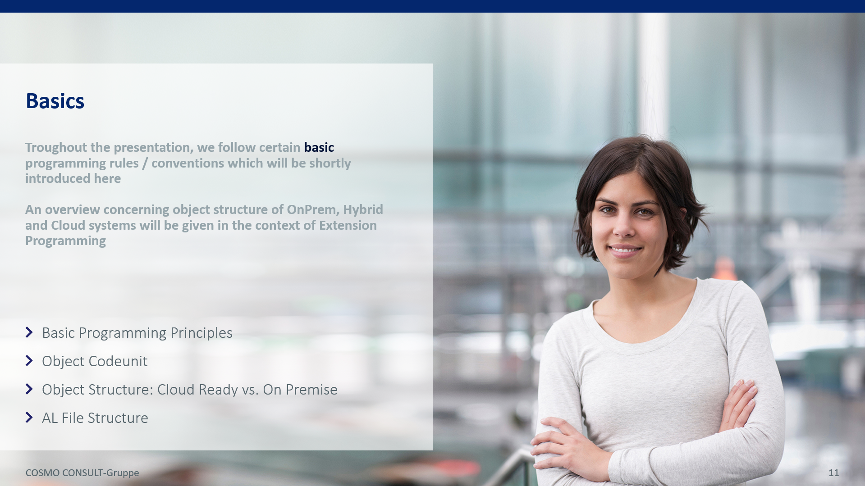
Agenda
1
→ Basis ←
2
Boundary Conditions / Setups: HowTo handle a Project - a Repetition
3
Programming in AL
4
Miscellaneous
5
Q & A

Slide 7
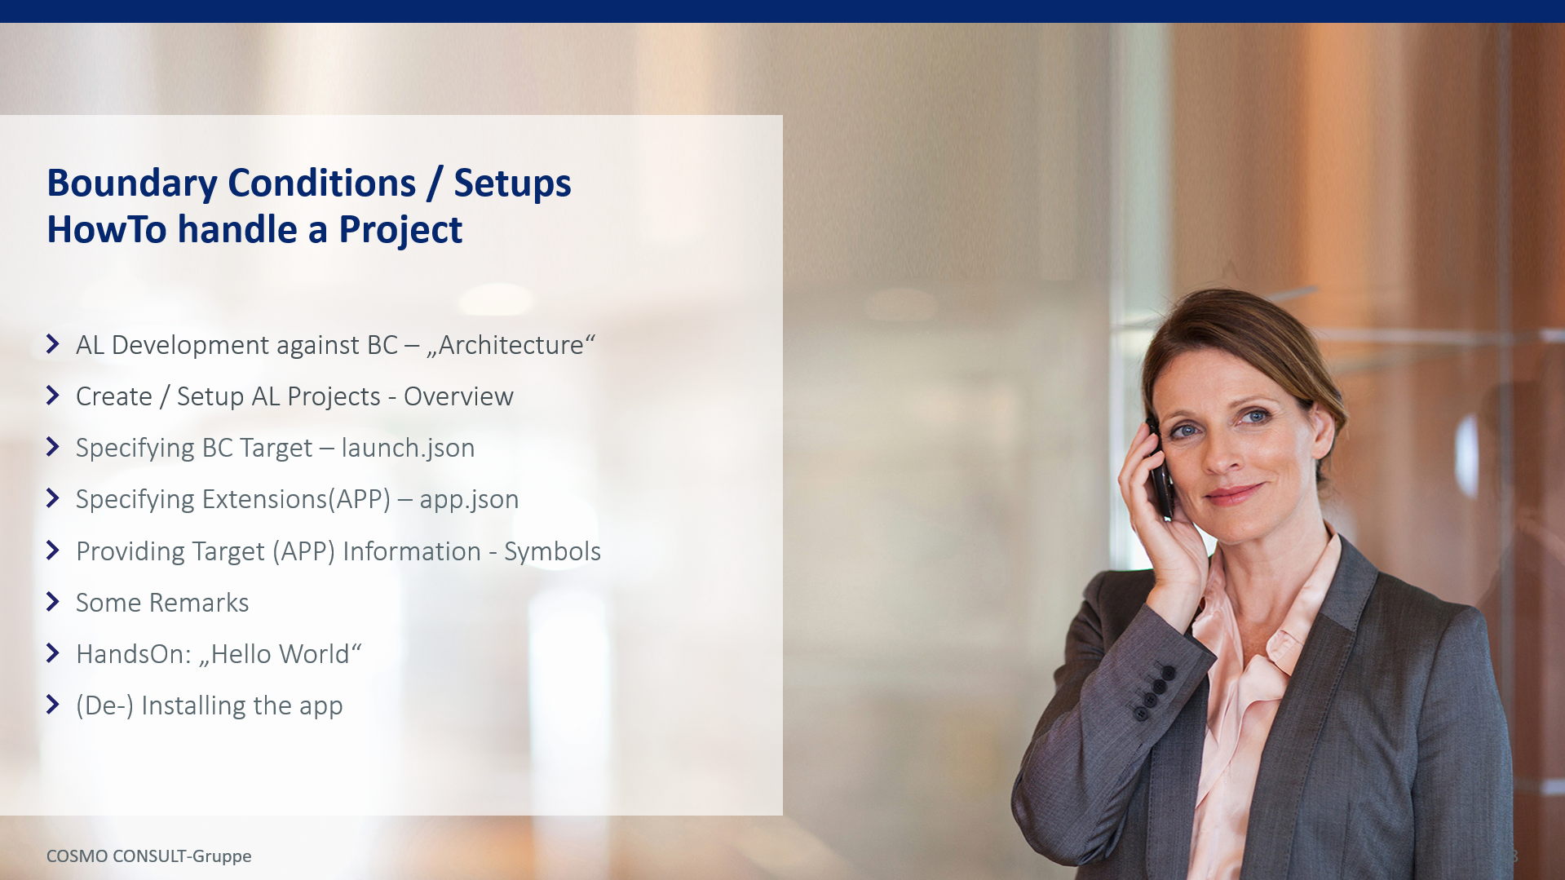
Agenda
1
Basis
2
→ Boundary Conditions / Setups: HowTo handle a Project – a short Repetition of “01-VisualStudioCode”?←
3
Programming in AL
4
Miscellaneous
5
Q & A

Slide 8
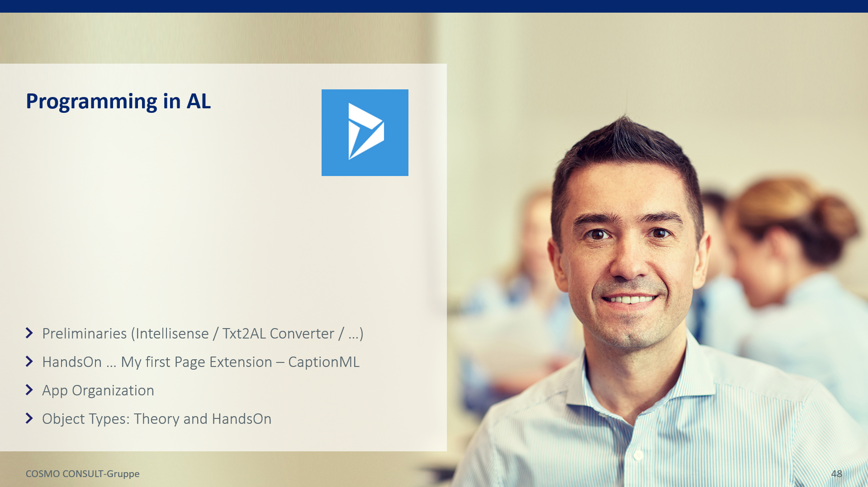
Agenda
1
Basis
2
Formalities / Boundary Conditions: HowTo handle a Project
3
→ Programming in AL ←
4
Miscellaneous
5
Q & A

Slide 9

Agenda
1
Basis
2
Formalities / Boundary Conditions: HowTo handle a Project
3
Programming in AL
4
→ Miscellaneous ←
5
Q & A

Slide 10
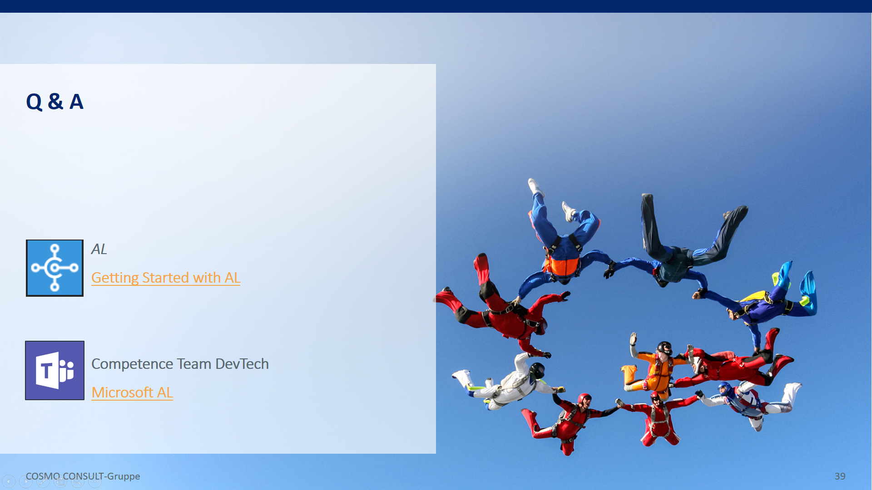
Agenda
1
Basis
2
Formalities / Boundary Conditions: HowTo handle a Project
3
Programming in AL
4
Miscellaneous
5
→ Q & A ←

Slide 11

Importants & Exercises
This workshop comes with an extra “Importants and Exercises” brochure (“06-AL-Importants and ExercisesXXX.pptx”) where you can find
Things to remember during the workshop
Things to look up during the workshop
Exercises

Slide 12

Basics
Basic Programming Principles
Object Codeunit
Object Structure: Cloud Ready vs. On Premise
AL File Structure
Troughout the presentation, we follow certain basic programming rules / conventions which will be shortly introduced here
An overview concerning object structure of OnPrem, Hybrid and Cloud systems will be given in the context of Extension Programming

Slide 13
Basics Basic Programming Principles
I
Agent Principle
Any function can be associated with an actor / agent, the acting entity. In consequence, the function should be located within this entity
II
Code belongs in Codeunits
As far as possible, code should be stored in containers, the Codeunits.
III
Minimum Footprint
Every implementation within standard / product code should be done minimally invasive
IV
Top Down Design /
Atomic Functions /
Natural Language Programming
Every implementation should read as a iterative sequence of natural language calls, the corresponding ”units” being as atomic (small) as possible. Programming language (nerdy stuff) should appear as late as possible.
Only relevant for OnPrem Implementations since Extensions are minimally invasive by construction

Slide 14
Basics Object Codeunit
An „Object Codeunit“ is assigned to each object
Elements of an Object Codeunit
Element
Naming
Example, agent: Purchase Header Table
Remark
Event Handler
(Event Subscriber)
Handle<Event Function>[<Event Publisher Element>]
HandleOnAfterValidateDocumentDate
DoThis(…);
DoThat(…);
Used for manipulating standard / third party behaviour
summarizes all subscriptions of an event in one subscriber, contains a list of the functionalities to be executed
Trigger Handler
(Global Function)
Handle<Trigger Name>[<Trigger Provider Element>]Trigger
HandleOnValidateMyNewFieldTrigger
DoLeft(…);
DoRight(…);
Used for manipulating behavior of “own elements”, e.g. the validation of “My New Field”
summarizes the functionality to be carried out when the trigger is called, defines “our standard behaviour”,contains a list of the functionalities to be executed
Agent Method
(Global Function)
“Name describes / promises behaviour”
PostDocument
Contains the code of a method of the agent. To be called via the agent only!
Local Helper
(Local Function)
“Name describes / promises behaviour”
DoThis
DoThat
DoLeft
DoRight
AppendVendorNo2PostingDescription

Slide 15


Basics Object Codeunit
Remarks
Collecting all ToDos in a single Event Handler instead of multiple Event Subscriptions provides a
Simple solution to the problem of undefined execution-order of subscriptions:
each event is subscribed once only
Integration of manual subscription might be done via „Event Switching Codeunits“

Slide 16
Basics: Cloud Ready Object Structure - bare Extension V2
C/Side (CAL)
Visual Studio Code AL
Standard Application
Project Implementations as Extensions v2
standard Table x
Tableextension x
Object CU Table x
Fields
additional Fields
Triggercode additional Fields
Methods
additional Methods
Code of additional Methods
Implicit/explicit Event Publisher
E
V
e
n
t
L
a
y
e
r
Unique Event Subscriber
New Functions
standard Page y
Pageextension y
Object CU Page x
Controls
additional Controls
Triggercode additional Controls
Actions
additional Actions
Triggercode additional Actions
Implicit/explicit Event Publisher
Unique Event Subscriber
New Functions
standard Codeunit z
Other APP Objects
Functions
Object CU Codeunit z
Explicit Event Publisher
Unique Event Subscriber
New Functions

Slide 17
Basics: Hybrid Object Structure – OnPremise only
C/Side (CAL)
Visual Studio Code AL
Standard Application
Project Implementations as Extensions v2
U
N
G
Ugly
NoGos
standard Table x
Tableextension x
Object CU Table x
Fields
additional Fields
Triggercode additional Fields
Methods
additional Methods
Code of additional Methods
Implicit/explicit Event Publisher
E
V
e
n
t
L
a
y
e
r
Unique Event Subscriber
Custom Event Publisher
C
u
s
t
o
m
E
V
e
n
t
L
a
y
e
r
New Functions
standard Page y
Pageextension y
Object CU Page y
Controls
additional Controls
Triggercode additional Controls
Actions
additional Actions
Triggercode additional Actions
Implicit/explicit Event Publisher
Unique Event Subscriber
Custom Event Publisher
New Functions
standard Codeunit z
Other APP Objects
Functions
Object CU Codeunit z
Explicit Event Publisher
Unique Event Subscriber
Custom Event Publisher
New Functions

Slide 18
Basics AL = File based programming ➔ File Structure
Considerations on the file structure will be made later on

Slide 19

Boundary Conditions / Setups HowTo handle a Project
AL Development against BC – „Architecture“
Create / Setup AL Projects - Overview
Specifying BC Target – launch.json
Specifying Extensions(APP) – app.json
Providing Target (APP) Information - Symbols
Some Remarks
HandsOn: „Hello World“
(De-) Installing the app

Slide 20
Boundary Conditions / Setups: HowTo handle a Project AL Development against BC – „Architecture“ → the Past
Microsoft Dynamics NAV
SQL Database
Development Environment
NAV Services
NAV Clients
„All“ Code within Database
…

Slide 21
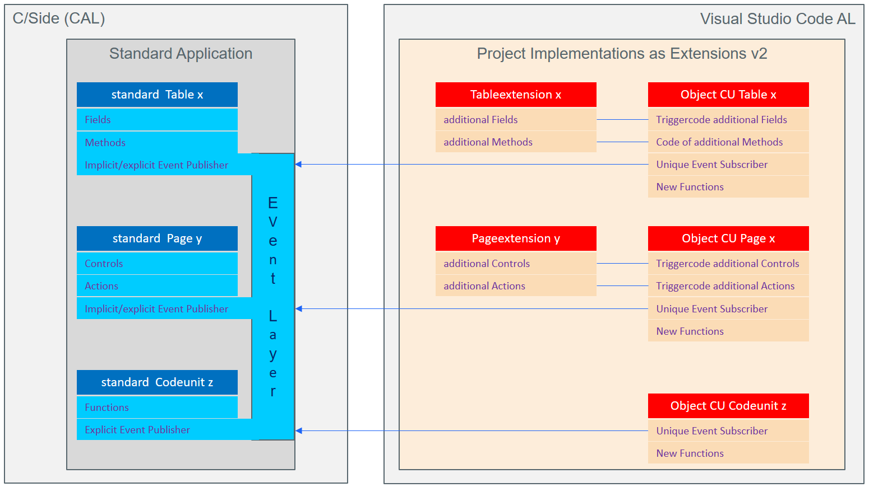
Boundary Conditions / Setups: HowTo handle a Project AL Development against BC – „Architecture“ → the Future
Microsoft Dynamics 365
Business Central
APPs / Extensions v2
Visual Studio Code
AL Language Extension
Code stored in File System
.al Files
Source Code Management (GIT)
Distributed Development
…
Modern Compiler
VS Code Extensions
Snippets (Macros)
…
SQL Database
„Classical“ Development Environment
BC Services
BC Clients
„Standard“ Code within Database
…
Seamless
coupling

Slide 22
Boundary Conditions / Setups HowTo handle a Project
AL Development against BC – „Architecture“
Create / Setup AL Projects - Overview
Specifying BC Target – launch.json
Specifying Extensions(APP) – app.json
Providing Target (APP) Information - Symbols
Some Remarks
HandsOn: „Hello World“
(De-) Installing the app

Slide 23
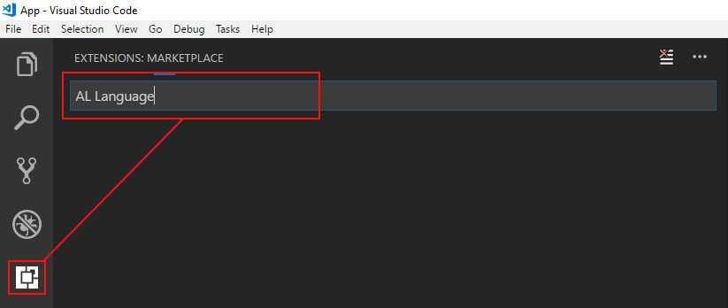
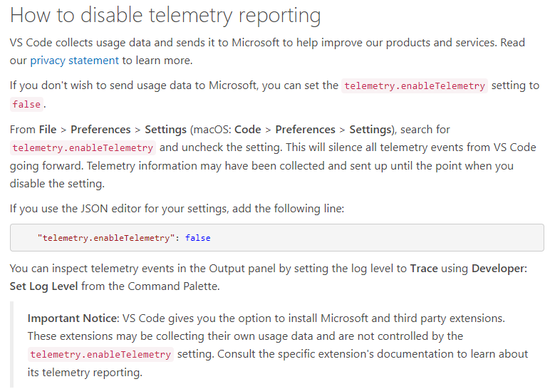
Boundary Conditions / Setups: HowTo handle a Project Create / Setup AL Projects – Overview → Installation & Setup of VS Code AL-Plugin
Download & Install Visual Studio Code
https://code.visualstudio.com/Download
Download & Install the AL Extension for Visual Studio Code
Open Visual Studio Code
Type „AL Language“ in the search box of the „Extensions“ section
Hit „Install“
Hit „Reload“ to relaunch VS Code
Eventually change Telemetry Setting
Eventually download and install „AL Code Outline“
AL code outline tree provider
Browse through meta data of standard objects
Autocreate GUI objects, … based on selected table
Eventuall download and install CRS AL Language Extension

Slide 24
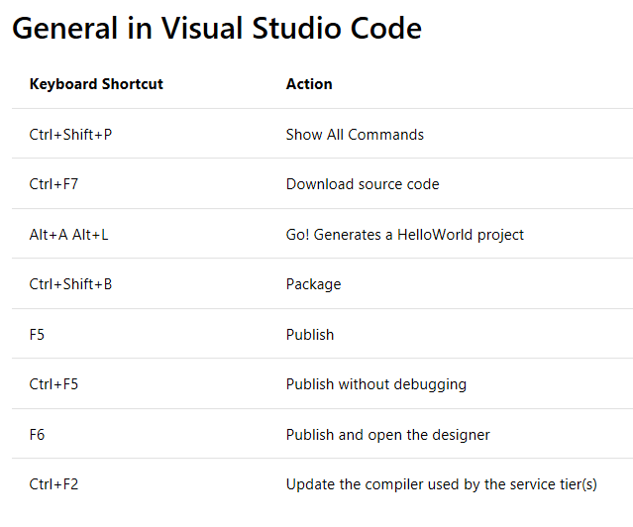
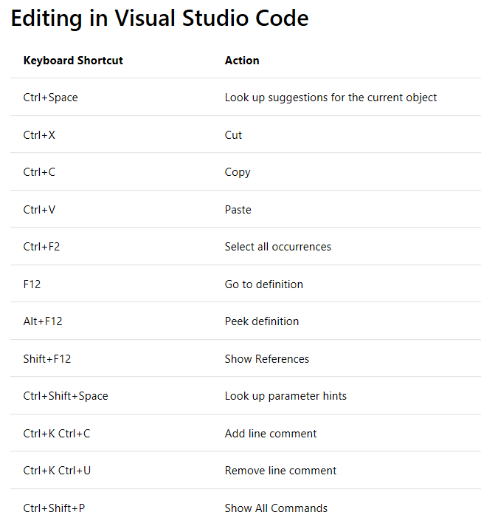
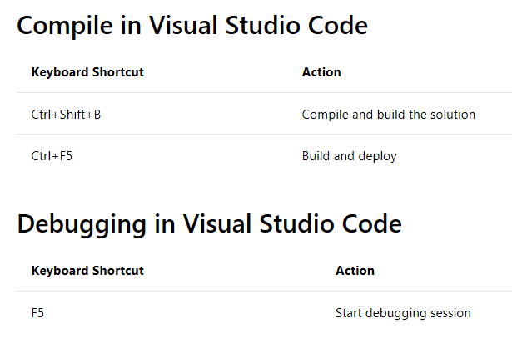
Boundary Conditions / Setups: HowTo handle a Project Create / Setup AL Projects – Overview → Important Shortcuts
https://docs.microsoft.com/en-us/dynamics365/business-central/dev-itpro/developer/devenv-keyboard-shortcuts
(F1)

Slide 25
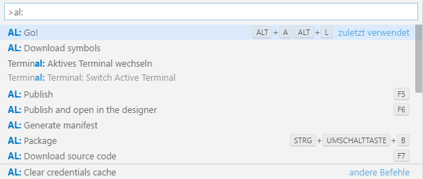
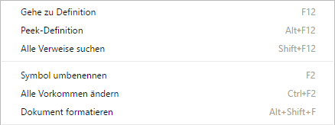
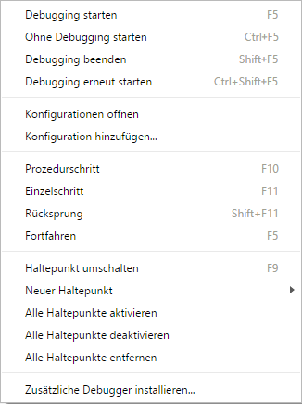
Boundary Conditions / Setups: HowTo handle a Project another list of Important Commands
VS Code Commands [Ctrl + Shift + P] or [F1]
AL: Go! [Alt + A] & [Alt + L]
AL: Download Symbols
AL: Package
AL: Download Source Code
AL: Publish
Keyboard Shortcuts [Ctrl + K] & [Ctrl + S]
Editor Commands
[F2] … Rename Object / Property / …
[F12] … Goto Definition
[Ctrl + F12] … Goto Implementation
[Shift + F12] … Show Where the reference is Used
[Ctrl + B] … Compile / Build
[F5] … Publish and Start
[Ctrl + F5] … Publish without Debug

Slide 26
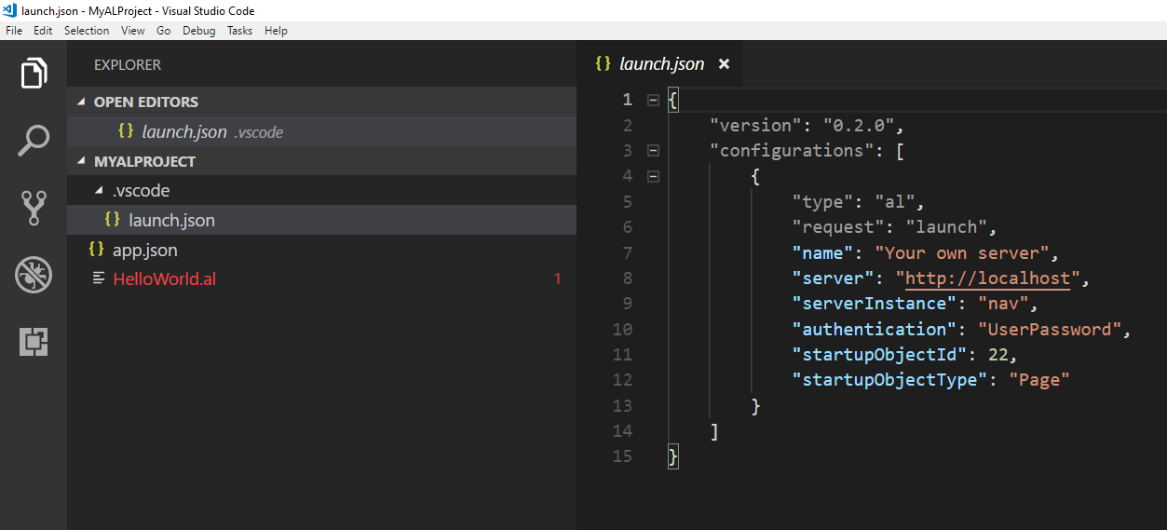
Boundary Conditions / Setups: HowTo handle a Project Create / Setup AL Projects – Overview → „Project Setup“
Load Template
Create „Hello World“
Open VS Code
Type F1 or Ctrl+Shift+P to open AL Command Line
Type a fragment of „AL: Go!“
Choose „AL: Go!“
Enter (AL) Project Path (…\...\HelloWorld)
Choose Environment (Cloud / OnPremise)
Oder: „Alt+A, Alt+L“
Configure Environment
Characterize your environment via proper values in the launch.json file
Define the APP
Characterize your APP via proper values in the app.json file
Introduce the Target DB‘s object structure to your APP
Download Symbols
Type F1 or Ctrl+Shift+P to open AL Command Line
Type a fragment of “Download Symbols”
Choose “Download Symbols”

Slide 27
Boundary Conditions / Setups HowTo handle a Project
AL Development against BC – „Architecture“
Create / Setup AL Projects - Overview
Specifying BC Target – launch.json
Specifying Extensions(APP) – app.json
Providing Target (APP) Information - Symbols
Some Remarks
HandsOn: „Hello World“
(De-) Installing the app

Slide 28
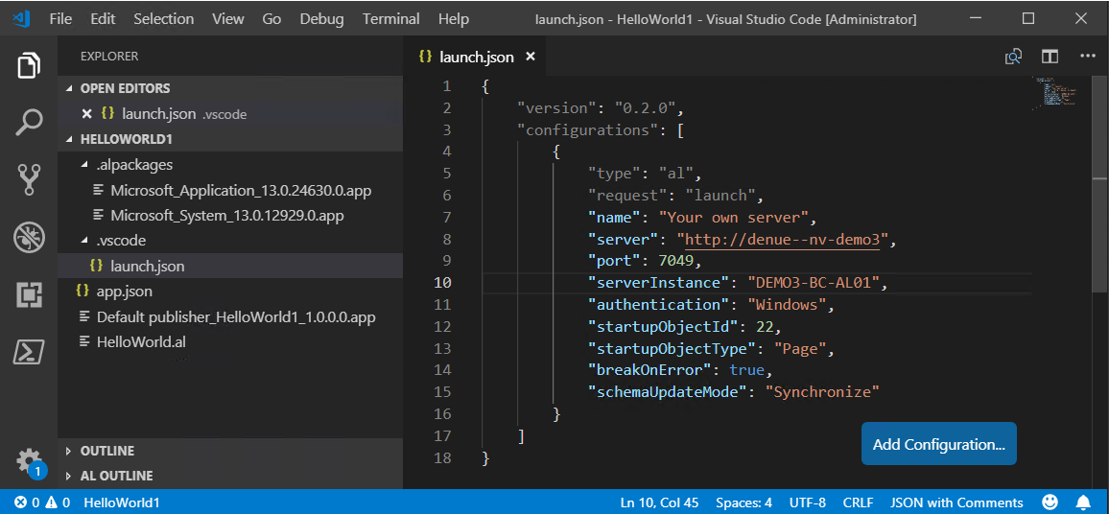
Boundary Conditions / Setups: HowTo handle a Project Specifying BC Target → launch.json
Defines the „Target System“ and how to start it
Located in „MyProject“/.vscode/launch.json https://docs.microsoft.com/en-us/dynamics365/business-central/dev-itpro/developer/devenv-json-files#Launchjson

Slide 29
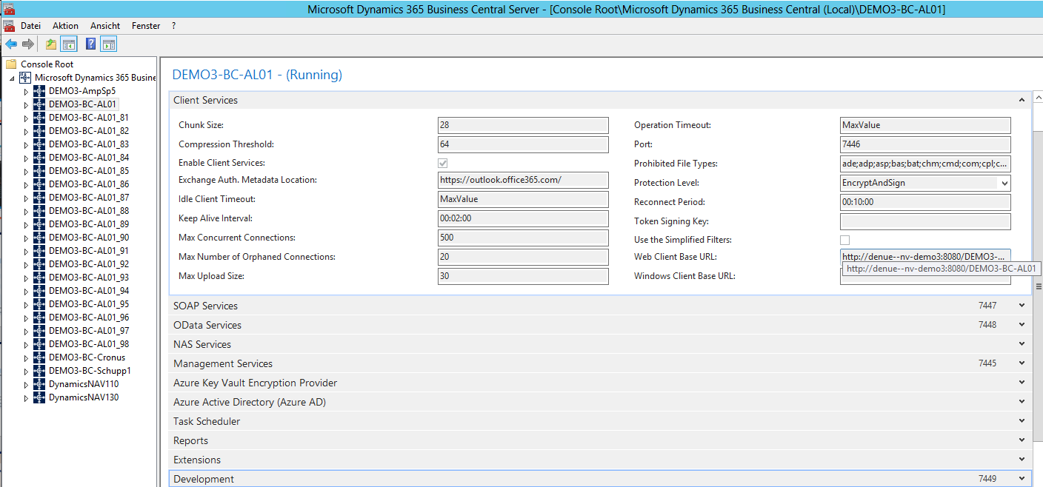
Boundary Conditions / Setups: HowTo handle a Project Specifying BC Target → launch.json
more detailed

Slide 30
Boundary Conditions / Setups: HowTo handle a Project Specifying BC Target → launch.json
Important Parameter
Parameter Name | Description | Remark
„name“ | Name of the „launcher“ | Arbitrary but mandatory
„type“ | „.al“ | Mandatory
„request“ | „launch“ | Mandatory
„server“ | NAV-Server HTTP-URL
„serverInstance“ | NAV-Server Instance-Name
“port“ | Development port | If „server“ not configured as „[URL]:[port]“
„authentication“ | NAV-Authentication | Possible Options AAD: Active Directory UserPassword: DB Windows
„startupObjectType“ | NAV Object-Type to run / start | Either „Page“ or „Table“ (ReadOnly)
„startupObjectID“ | NAV Object-ID of Object to be started

Slide 31
Boundary Conditions / Setups: HowTo handle a Project Specifying BC Target → launch.json
Important Parameter
Parameter Name | Description | Remark
„schemaUpdateMode“ | Data / schema synchronization mode | Either „Synchronize“ Tries synchronizing table fields. Fails if data could be lost. → „No Destructive Changes“ or „Recreate“ Deletes and creates the tables afterwards. All data will be lost → Upgrade-Code needed! C.f. 1
breakOnError | Specifies whether to break on errors when debugging. The default value is true
breakOnRecordWrite | Specifies if the debugger breaks on record changes. The default value is false
1: https://docs.microsoft.com/en-us/dynamics365/business-central/dev-itpro/developer/devenv-retaining-data-after-publishing

Slide 32
Boundary Conditions / Setups HowTo handle a Project
AL Development against BC – „Architecture“
Create / Setup AL Projects - Overview
Specifying BC Target – launch.json
Specifying Extensions(APP) – app.json
Providing Target (APP) Information - Symbols
Some Remarks
HandsOn: „Hello World“
(De-) Installing the app

Slide 33
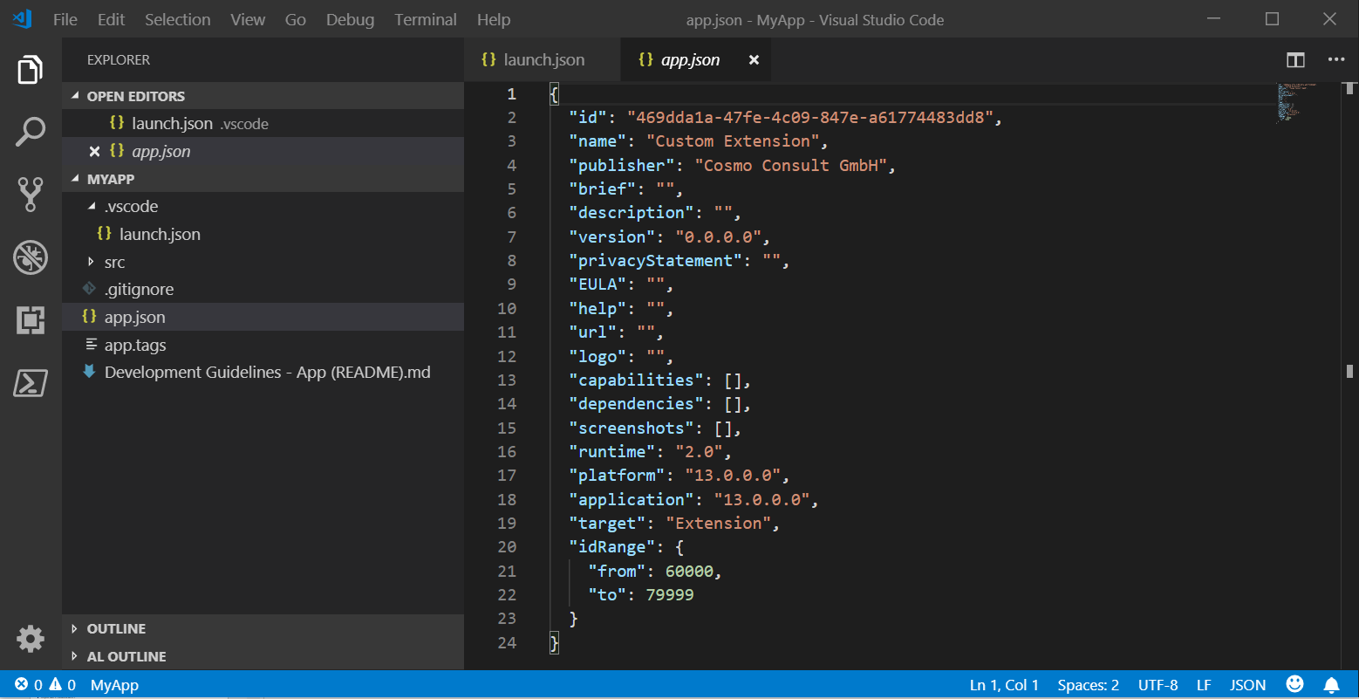
Boundary Conditions / Setups: HowTo handle a Project Specifying Extensions (APP) → app.json
Defines the „APP“ to be created via the AL Project
Located in „MyProject“/app.json https://docs.microsoft.com/en-us/dynamics365/business-central/dev-itpro/developer/devenv-json-files#appjson-file

Slide 34
Boundary Conditions / Setups: HowTo handle a Project Specifying Extensions (APP) → app.json
Important Parameters I
Parameter Name | Description | Remark
„id“ | Unique ID of the APP (Extension) | Generated automatically while project is created Mandatory
„name“ | Unique name of the APP ( Extension) | Might be the project name, the project number or the name of the customer in the case of a customer project. Mandatory
„publisher“ | Name of the publisher of the APP (Extension) | Might be „Cosmo Consult“? Mandatory
„version“ | Version of the APP (Extension) | Mandatory
„platform“ | Minimum NAV-Version for platform-symbols (system tables) | Mandatory for using system tables
„application“ | Minimum NAV-Version for application-symbols (application objects) | Mandatory for using application objects
„idRange(s)“ | Restriction of object Ids used by the APP (Extension) | Example: "idRanges": [{"from": 50100,"to": 50200},{"from": 50202,"to": 50300}]. Error occurs if object is created outside this range(s) ID is automatically suggested Use either „idRange“ or „idRanges“!
„showMyCode“ | Enables debugging of the source code of the extension | Possible „options“ true false (default)

Slide 35
Boundary Conditions / Setups: HowTo handle a Project Specifying Extensions (APP) → app.json
Important Parameters II
Parameter Name | Description | Remark
„target“ | Defines the type of APP (Extension) | Possible values Level 0: „Personalization“ only allows for inclusion of UI objects like Profiles/PageCustomizations Level 1: „Extension“ (Default) Only global C/Side Functions with „FunctionVisibility“=„External“ are accessible Level 2: Solution Unused at the moment, this (or something very like it) will be used to encompass the capabilities of 'Embed' apps in the future Level 3: „Internal“ All global C/Side functions accessible NAV-Server setting „ExtensionAllowedTargetLevel“ must be „internal“, too NAV Server setting „ExtensionAllowedTargetLevel“ should probably be as high as the desired APP level. Otherwise, the APP can not be installed (c.f.1)
„brief“ | Short description of the extension | Mandatory for App Source submission
„description“ | Longer description of the extension | Mandatory for App Source submission
„…….“ | Other App Source relevant properties
„dependencies“ | List of dependencies to other apps
„logo“ | Relative path to the app package logo from the root of the package. | Mandatory for App Source submission nice otherwise
1: https://github.com/Microsoft/AL/issues/734

Slide 36
Boundary Conditions / Setups: HowTo handle a Project Specifying Extensions (APP) → app.json
Important Parameters III
Parameter Name | Description | Remark
„helpBaseUrl“ |  | The URL for the website that displays help for the current extension. The default URL is https://docs.microsoft.com/{0}/dynamics365/business-central.
„supportedLocales“ |  | The list of locales that are supported for looking up help. The value on the list is inserted into the URL defined in the helpBaseUrl property. The first locale on the list is default. An example is "supportedLocales": ["da-DK", "en-US"].
1: https://github.com/Microsoft/AL/issues/734

Slide 37
Boundary Conditions / Setups HowTo handle a Project
AL Development against BC – „Architecture“
Create / Setup AL Projects - Overview
Specifying BC Target – launch.json
Specifying Extensions(APP) – app.json
Providing Target (APP) Information - Symbols
Some Remarks
HandsOn: „Hello World“
(De-) Installing the app

Slide 38
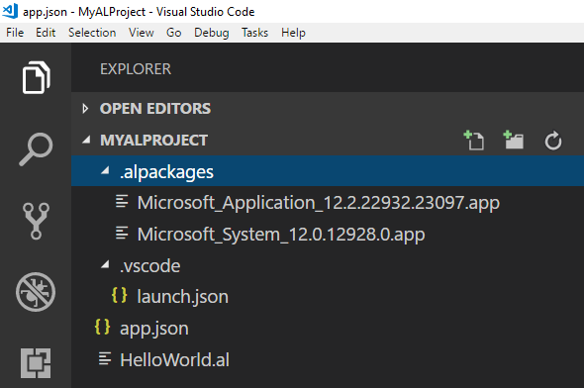
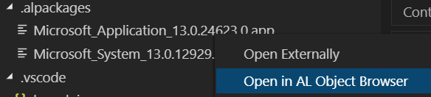
Boundary Conditions / Setups: HowTo handle a Project Providing Target (APP) Information → symbols
Metadata of the objects (Platform & Application) with references to fields, functions, etc. are supplied „via symbols“
No symbols → no Extension programming
Symbol download from target server yields package files in the „./.alpackages“ folder of the project
Hybrid Environments
Symbols have to be generated and downloaded „whenever“ changes in C/Side are made
Generate symbols continuously: use „generatesymbolreference“ option of finsql.exe (c.f. https://docs.microsoft.com/en-us/dynamics-nav/developer/devenv-running-cside-and-al-side-by-side)
Symbol download successful but „no symbols present“
Check symbol presence e.g. via object browser
If standard symbols missing, run
„<PathToFinSql>\finsql.exe" Command=generatesymbolreference, Database=<DataBase>, ServerName=<NAVServerInstance>
to (re-)generate symbols – might be a lengthy operation

Slide 39
Boundary Conditions / Setups HowTo handle a Project
AL Development against BC – „Architecture“
Create / Setup AL Projects - Overview
Specifying BC Target – launch.json
Specifying Extensions(APP) – app.json
Providing Target (APP) Information - Symbols
Some Remarks
HandsOn: „Hello World“
(De-) Installing the app

Slide 40
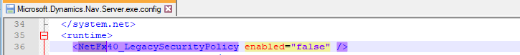
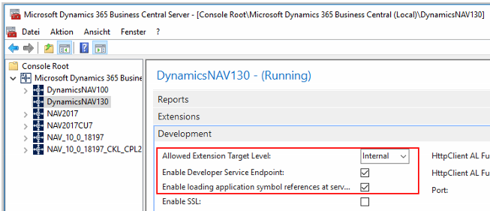
Boundary Conditions / Setups: HowTo handle a Project Some Remarks
Always run VS Code „as Admin“
„Typical errors“, occuring while symbol downloading
[2018-11-06 16:39:58.11] The request for path /DynamicsNAV130/dev/metadata failed with code InternalServerError. Reason: NetFx40_LegacySecurityPolicy is enabled and must be turned off in the Microsoft.Dynamics.Nav.Server.exe.config file.
Solution: change “true” to “false” in NetFx40… key of config file
[2018-11-07 10:51:10.93] Error: Could not open the specified startup page. Please check that the server configuration key PublicWebBaseUrl has been properly set.

Slide 41
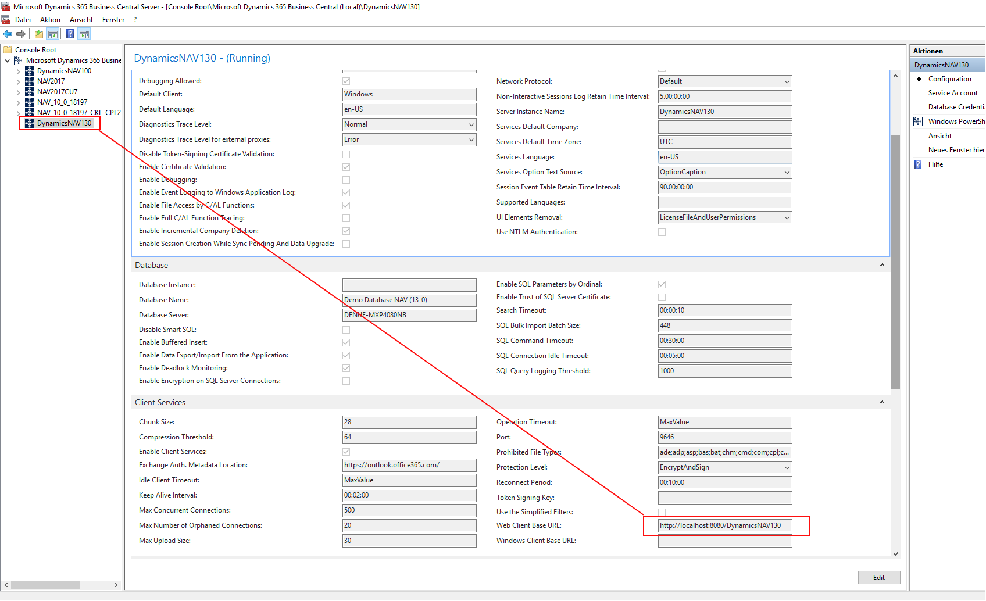
Boundary Conditions / Setups: HowTo handle a Project Some Remarks
“Typical errors”, occurring while publishing “Hello World”
VS Code not executed „as administrator“
[2018-11-07 10:51:10.93] Error: Could not open the specified startup page. Please check that the server configuration key PublicWebBaseUrl has been properly set. ← Define Setting and Restart VS Code
If things don‘t work as expected:
Restart VS Code
(e.g., if you‘ve changed the „Web Client Base URL“

Slide 42
Boundary Conditions / Setups: HowTo handle a Project Some Remarks
“You cannot connect to the Classic Development Environment (Cside)”
Perhaps, prerequisites are missing, Whether you are running CSide using Click-Once, through the navcontainerhelper or you manually copied the binaries to a shared folder, you need to have the pre-requisites installed on the computer on which you are running CSide. If CSide complains about missing DLL's or giving an ODBC error, you probably need to install these pre-requisites:
https://download.microsoft.com/download/2/E/6/2E61CFA4-993B-4DD4-91DA-3737CD5CD6E3/vcredist_x86.exe
https://download.microsoft.com/download/3/A/6/3A632674-A016-4E31-A675-94BE390EA739/ENU/x64/sqlncli.msi

Slide 43
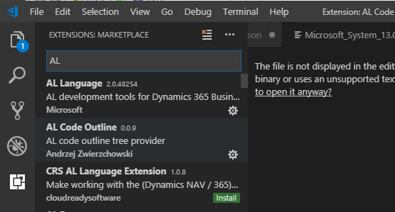
Boundary Conditions / Setups: HowTo handle a Project Some Remarks
“For later purposes – to get insights into “app-packages” : Install “AL Code Outline”

Slide 44
Boundary Conditions / Setups HowTo handle a Project
AL Development against BC – „Architecture“
Create / Setup AL Projects - Overview
Specifying BC Target – launch.json
Specifying Extensions(APP) – app.json
Providing Target (APP) Information - Symbols
Some Remarks
HandsOn: „Hello World“
(De-) Installing the app

Slide 45

HandsOn – Exercise 1 | Hello World: our very first page extension
HandsOn
Understand the Example Extension „Hello World“
Configure your Environment / Run the Example
Load Template
Create „Hello World“
Open VS Code
Type F1 or Ctrl+Shift+P to open AL Command Line
Type a fragment of „AL: Go!“
Choose „AL: Go!“
Enter (AL) Project Path
Choose Environment (Cloud / OnPremise)
Oder: „Alt+A, Alt+L“
Configure Environment
Characterize your environment via proper values in the launch.json file
Define the APP
Characterize your APP via proper values in the app.json file
Introduce the Target DB‘s object structure to your APP
Download Symbols
Type F1 or Ctrl+Shift+P to open AL Command Line
Type a fragment of “Download Symbols”
Choose “Download Symbols”
If things don‘t work as expected:
Restart VS Code
(e.g., if you‘ve changed the „Web Client Base URL“
Compile / Publish /
Install / Launch
the APP
Hit „F5“ in VS Code ….

Slide 46
Boundary Conditions / Setups HowTo handle a Project
AL Development against BC – „Architecture“
Create / Setup AL Projects - Overview
Specifying BC Target – launch.json
Specifying Extensions(APP) – app.json
Providing Target (APP) Information - Symbols
Some Remarks
HandsOn: „Hello World“
(De-) Installing the app

Slide 47
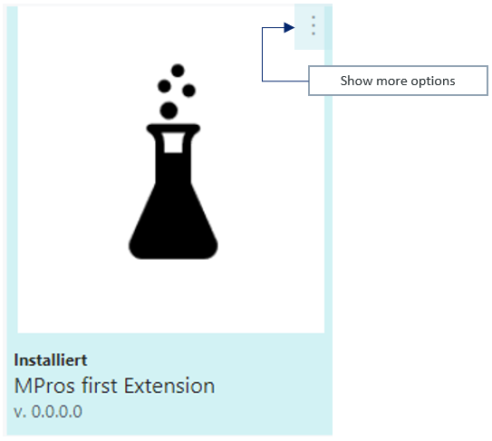
HandsOn – Exercise 2 | Deinstalling the app (via Client)
HandsOn
Open Client
Search „Extension Management“
Press “Show more options”
and choose “Uninstall”
Extension is now „Uninstalled“
but not „Unpublished“
Press “Show more options”
and choose “Unpublish”
Extension is now
„no longer available on the system“
Learn - Why this 2 step procedure?
To be able to have an extension available on dedicated tenants only
→ publish into a data base
→ Install into a tenant
!! data remains !!

Slide 48
Boundary Conditions / Setups: HowTo handle a Project Installing the app via Client
On Premise, at the moment, there is no way of installing an app from within client
Installing via Powershell: wait for later

Slide 49


Programming in AL
Preliminaries (Intellisense / Txt2AL Converter / …)
HandsOn … My first Page Extension – CaptionML
App Organization
Object Types: Theory and HandsOn

Slide 50
Programming in AL
Preliminaries (Intellisense / Txt2AL Converter / …)
HandsOn … My first Page Extension – CaptionML
App Organization
Object Types: Theory and HandsOn

Slide 51
Programming in AL Preliminaries (Intellisense / Txt2AL Converter / CodeCops / Snippets)
Context Intellisense
shows what is possible in the current context of the cursor.
Possible Properties
Possible Property-Values
Next possible Object-/Field-ID
Eventing: Parametervorschlag auf Basis der Publisher Eigenschaften
…
Shortcut: Ctrl+Space
If you don‘t know, what to do - 1: Press „Ctrl+Space“

Slide 52
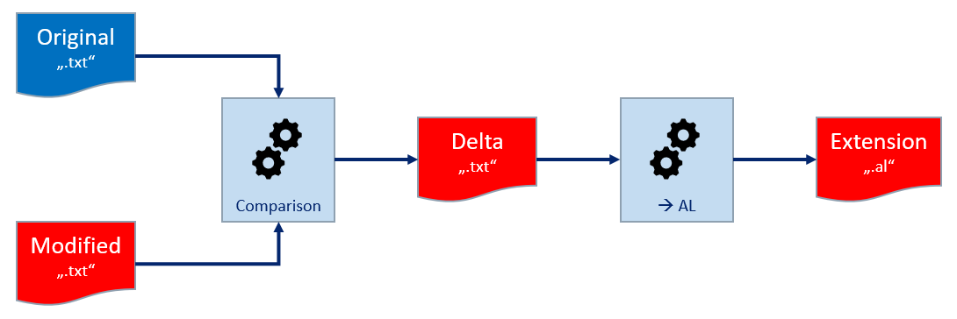
Programming in AL Preliminaries (Intellisense / Txt2AL Converter / CodeCops / Snippets)
Txt2AL Converter
converts Deltas into AL
Missing „Original“ → whole „Modified“ is transformed
Thus: standard objects can be transformed into AL
Allows to see how whole C/AL constructs transform into AL
If you don‘t know, what to do - 2: Use Txt2AL Converter

Slide 53
Programming in AL Preliminaries (Intellisense / Txt2AL Converter / CodeCops / Snippets)
Txt2AL Converter consists of
CAL2Extension … .ps1
Converts Object [Type, ID] into al-file
Stores result in „$WorkingDir + \CAL2EXT“ and/or subdirs
Needs
„$DatabaseServer“: SQL Server of DB
„$DatabaseName“
„$PathToRTCDir“
„$PathToText2ALExe“ (shoud be „$PathToRTCDir + \txt2al.exe“)
Optional: „$OriginalsSourceDir“
If given, script uses files to compare to, thus generates Extension by transforming deltas
If not given: converts objects into al as a whole …
BulkCAL2Extension … .ps1
Holds list of objects to be transformed
Transforms objects one by one using „CAL2Extension … .ps1“
At the moment, the scripts which wrap the converter are „crusher bar implementations“ which are in urgent need of improvement

Slide 54
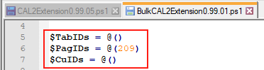
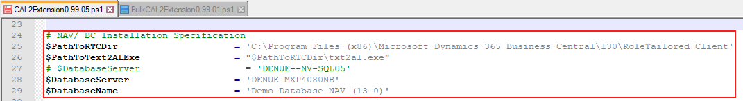
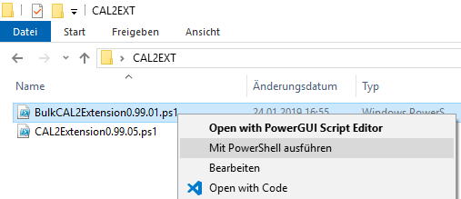
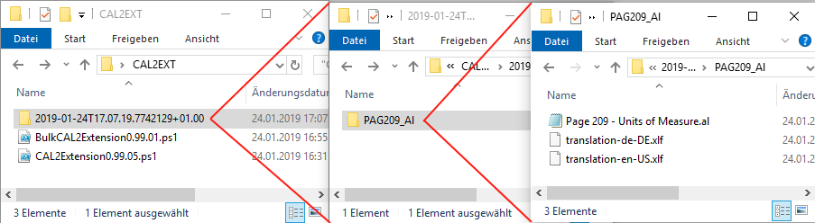
HandsOn
HandsOn – Exercise 3 | Configuring the Txt2AL Converter
Txt2AL Converter - HandsOn: Convert page „Units of Measure (209)“
Configure Converter
SQL-Server
Convert page „Units of Measure (209)“

Slide 55
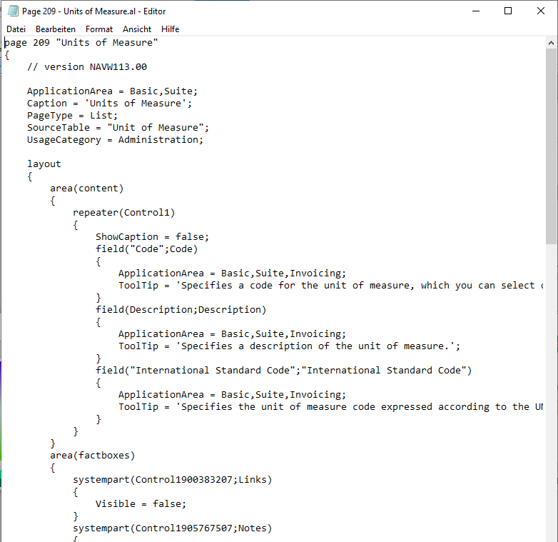
HandsOn
HandsOn – Exercise 3 Continued | Configuring the Txt2AL Converter
Result

Slide 56
Programming in AL Preliminaries (Intellisense / Txt2AL Converter / CodeCops / Snippets)
Just to mention them at this point, details will follow below
Code Analysis / CodeCops
functionality to have the code checked automatically on different subtlety levels
Snippets: Macros within Visual Studio Code
Macro recorde existing (Visual Studio Code Extension)
Basic snippets predefined:
type „t<snippet name>“ to activate AL snippet
If you don‘t know, what to do - 3: Press „t<context>“

Slide 57
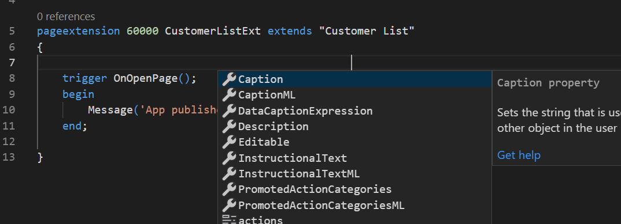
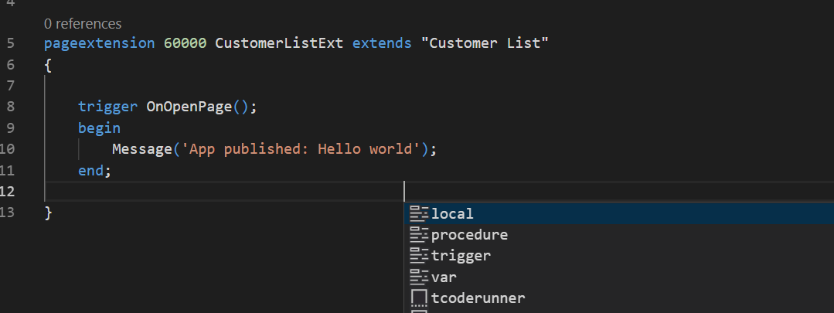
HandsOn – Exercise 4 | intelliSense
HandsOn
Open VS Code on „HelloWorld“ Project
Open file „HelloWorld.al“
Place the cursor above “trigger OnOpenPage()”
and press “Ctrl+Space” to activate Intellisense
Place the cursor below “trigger OnOpenPage()” block
and press “Ctrl+Space” again
Learn that
the suggestions depend on the actual context of your code – it’s “Intelli”
Elements of an object have to be placed in a certain order …. .

Slide 58
Programming in AL
Preliminaries (Intellisense / Txt2AL Converter / …)
HandsOn … My first Page Extension – CaptionML
App Organization
Object Types: Theory and HandsOn

Slide 59
HandsOn – Exercise 5 | CaptionML
HandsOn
Open VS Code on „HelloWorld“ Project
Open Page Extension „HelloWorld.al“
Find „Property Area“ of the object
Add CaptionML Property via intelliSense
Run Extension
Verify new page caption
Learn Syntax
CaptionML = ENU = 'List of Customers’,
DEU = 'Liste der Kunden';

Slide 60
Programming in AL
Preliminaries (Intellisense / Txt2AL Converter / …)
HandsOn … My first Page Extension – CaptionML
App Organization
Object Types: Theory and HandsOn

Slide 61
Programming in AL APP Organization - Unique Namespace: Prefixing
Forced by the possibility of changing environment: suitable Prefixing to create uniqueness
(separated by a „Space“ from the object‘s name)
Use the Prefix CCO (Cosmo Consult Operations) for the following:
Objects
Name
Object Codeunits
Name
Object Extensions
Name
Global Procedures
Fields (Table)
Keys / KeyNames
Controls (Page)
Actions (Page)
Values (Enum)
Prefix „CCOT“ for Test Objects

Slide 62
Programming in AL APP Organization - Philosophy
Philosophy
Group together what belongs together
Forget about IDs as sort criterion
Create an understandable and easily enforceable rule on where code should be stored and how files should be named
„Agent Folder“ Table x
Table x
or
Extension of Table x
Object Codeunit of Table x
xliff ?
log of Table x
„Agent Folder“ Page y
Page y
or
Extension of Page y
Object Codeunit of Page y
xliff ?
log of Page y
„Agent Folder“ Report z
Report z
or
(Report Extension)
Object CU of Report z
Layout
xliff ?
log of Report z
„Agent Folder“ Codeunit u
Codeunit u
Object CU of Codeunit u
xliff ?
log of Codeunit u
„Agent Folder“ XML Port v
XML Port v
or
(?XML Port Extension?)
Object CU of XML Port v
xliff ?
log of XML Port v
„Agent Folder“ Query w
Query w
or
(?Query Extension?)
Object CU of Query w
xliff ?
log of Query w
„Agent Folder“ Enum q
Enum q
or
Enum Extension
xliff ?
log of Enum q
„Agent Folder“ Ctrl Add-In r
Control Add-In r
Object CU of Ctrl. Add-In r
xliff ?
log of Ctrl Add-In r

Slide 63
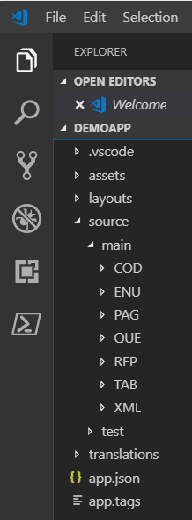
Programming in AL APP Organization - Enveloping Folder Structure
contains „launch.json“
contains assets like a logo …
contains report layouts to be published (c.f. below.)
organizes the actual program files, distinguishes …
„main“: distinguishes object types via subfolder structure <type>
<type> folders: contains agent object folders (location of program files, c.f. below)
„test“: contains test codeunits per GAP
contains translation file of the app, if existing (c.f. below.)
app.json file
app.tags (file): contains collection of „GAP“-tags representing al GAPs implemented so far, c.f. below

Slide 64
Programming in AL APP Organization - Naming Conventions Agent Folders / Files
Folder Names
<Type>
.
<Agent Object Name, abbreviated>
[.<Origin>]
File Names
<Type>
.
<Agent Object Name, abbreviated>
[.<Origin>]
[.<Subtype>]
.al
Object Names
CCO
[Agent Type]
<Agent Object Name>
[_+]
Log File
<Folder Name>
.log
(for docu-purposes, c.f. below)
Type
denotes the Object Type of the source Object
could be TAB, PAG, REP, COD, …
„abbreviated“
means without spaces …,
as suggested as Variable Name by the Object Designer
„Purchase Header → PurchaseHeader“
Origin
[„“,“cc“]; „“ if Object is app-external „cc“ if Object is app object
Subtype
[„“, „ext“, „code“]; „ext“ for extension objects; „code“ for Object Codeunits
„Agent Type“
Used for Object CUs only: indicates the type of the related object [T, P, R, X, C, …]
Appendix „+“
indicates in object names that the object extends a standard object.

Slide 65
Programming in AL APP Organization - Naming Conventions: Examples)
Object | Name of Object File | Name of Object | Object Folder
Tableextension Example 1: Item Example 2: Purchase Header | TAB.<Name of extended Tab, …>.ext.al TAB.Item.ext.al TAB.PurchaseHeader.ext.al | CCO_<Name of extended Tab>_+ "CCO Item +" "CCO Purchase Header +" | TAB.<Name Table, …> TAB.Item TAB.PurchaseHeader
Pageextension Example: Item Card | PAG.<Name of extended Page, …>.ext.al PAG.ItemCard.ext.al | CCO_<Name of extended Page>_+ "CCO Item Card +" | PAG.<Name of Page, …> PAG.ItemCard
Table (== new Table) Example: My App Table | TAB.<Name of new Table, …>.al TAB.MyAppTable.cc.al | CCO_<Name of new Table> "CCO My App Table" | TAB.<Name Table, …>.cc TAB.MyAppTable.cc
Page (== new Page) Example: My App Page | PAG.<Name of new Page, …>.al PAG.MyAppPage.cc.al | CCO_<Name of new Page> "CCO My App Page" | PAG.<Name of Page, …>.cc PAG.MyAppPage.cc
Report (== new Report) Example: My App Report | REP.<Name of new Report, …>.al REP.MyAppReport.cc.al | CCO_<Name of new Report> "CCO My App Report" | REP.<Name of Report, …>.cc REP.MyAppReport.cc
ObjectCU of APP-external Tabelle Example 1: Item Example 2: Purchase Header | TAB.<Name of Table, …>.code.al TAB.Item.code.al TAB.PurchaseHeader.code.al | CCO_T_<Name of Table>_+ "CCO T Item +" "CCO T Purchase Header +" | TAB.<Name of Table, …> TAB.Item TAB.PurchaseHeader
ObjectCU of APP-internal Tabelle Example: My App Table | TAB.<Name of new Table, …>.cc.code.al TAB.MyAppTable.cc.code.al | CCO_T_<Name of Table> "CCO T My App Table" | TAB.<Name of Table, …>.cc TAB.MyAppTable.cc
ObjectCU of APP-external Page Example: Item Card | PAG.<Name of Page>.code.al PAG.ItemCard.code.al | CCO_P_<Name of Page>_+ "CCO P Item Card +" | PAG.<Name of Page, …> PAG.ItemCard
ObjectCU of APP-internal Page Example: My App Page | PAG.<Name of Page>.code.al PAG.MyAppPage.cc.code.al | CCO_P_<Name of Page> "CCO P My App Page" | PAG.<Name of Page, …>.cc PAG.MyAppPage.cc
ObjectCU of APP-external Report Example: Order Confirmation | REP.<Name of Report>.code.al REP.OrderConfirmation.code.al | CCO_R_<Name of Report> "CCO R Order Confirmation +" | REP.<Name of Report, …> REP.OrderConfirmation
ObjectCU of APP-internal Report Example: My App Report | REP.<Name of Report>.code.al REP.MyAppReport.cc.code.al | CCO_R_<Name of Report> "CCO R My App Report +" | REP.<Name of Report, …>.cc PAG.MyAppReport.cc
… | … | … | …

Slide 66
Programming in AL APP Organization - Documentation: log-files and app-tags
Documentation via Log Files
One Log per Folder
Log file contains well known docu headers (per GAP)
<GAP-Tag>_<Date>_<Developer ID>: <Title of GAP>
Information on changes …
A „GAP-Tag“ consists of the GAP Identifier and a two digit suffix counting the generations of implementations of the gap.
If a GAP Implementation tsarts, the suffix is „.01“, if is reopened after a first completion, it gets suffix „.02“ and so on.
GAP-FI-001.01 01.01.2019 DENUE.MPRO: Default Description
Created
New field 55000 „Description 3“
Modified
…..
Remark: perhaps, we will be able to skip documentation in the future, using Azure DevOps …

Slide 67
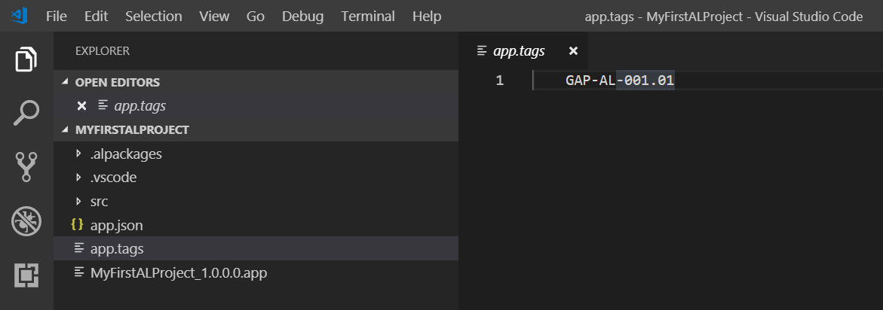
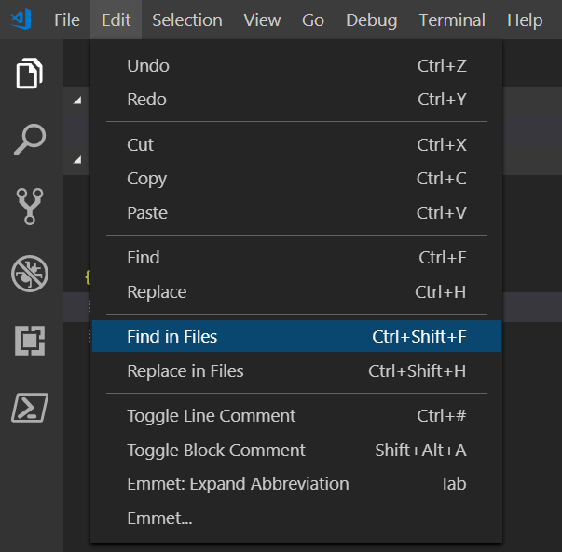
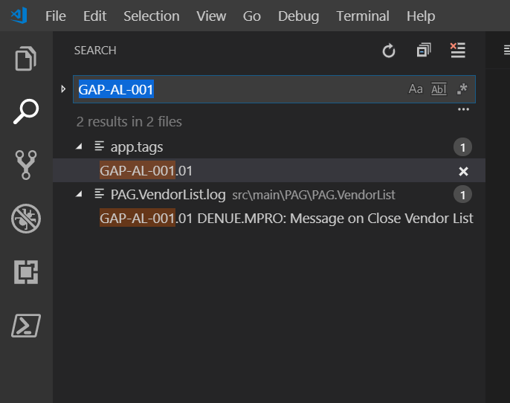
Programming in AL APP Organization - Documentation: log-files and app-tags
The „app.tags“ file
Loctaed in the root folder of the app
Contains al list of the GAPs implemented up to the current project state
[GAP-ID].[xx]: the „xx“ denotes the „development phase“ of the GAP
Enables „app-wide“ search for GAP Implementations

Slide 68
Programming in AL APP Organization (Naming Convention ← why that mess)
Folder
To be able to recognize the contents of a(n)
File
by its name
?? necessary ??
Object
Useful when looking at the al file structure
Useful when looking into an al folder
Useful when looking into an object file
Useful when using symbols

Slide 69
Programming in AL APP Organization (Naming Convention ← Remarks)
„…" means "variable-like abbreviated„
Obviously, there is at maximum one ObjectCU for a object and its extension.
The ObjectCU holds the code of the object and its extension.
If you extend an (third party) extension, prefixes are to be inherited
E.g., for the "AMP" table "Table", the table extension would be named "TAB. AMPTable.ext.al", the object "CCO AMP Table +" …
?? necessary ??

Slide 70
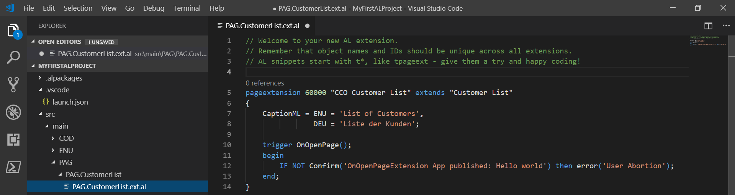
HandsOn
HandsOn – Exercise 6 | AL file structureProgramming in AL
AL Project: Setting up the proper File / Folder structure
Clean up your project
Open „Hello World“ Project
Setup a proper file / folder Structure
Eventually rename your object files
Eventually rename your objects

Slide 71
HandsOn
HandsOn – Exercise 7 | Codeunits and the Txt2AL Converter
Excercise CU programming via Txt2AL converter: Message on open Vendor List
Open C/Side Dev Environment
Create Codeunit 55000 „CCO P Vendor List +“
Add some properties to the CU, e.g.
TableNo = Vendor
Add Event Subscriber „HandleOnOpenPage“
Add function „LaunchMessageVendorListIsOpen“
Call function from within subscriber
Implement the Object CU „classically“
Test Functionality
Convert to AL
Configure and use Txt2AL converter
Remove Codeunit from object designer
Eventually create the Project, setup app.json / launch.json
Setup proper file structure
Integrate the converted file
View file content
Integrate solution into „MyFirstALProject“
Run the Project
Eventually modify „launch.json“ to get vendor list launched immediately

Slide 72
HandsOn
HandsOn – Exercise 7.5 | Extension Programming and the Txt2AL Converter
Extension programming via Txt2AL converter – GAP-AL-000: „Description 3“ on „Item Card“
New „Description 3“ field in table „Item“, shown on „Item Card“
New Action on „Item Card“ to copy „Description 3“ from „Description“
Open C/Side Dev Environment
Create backup of table „Item“ and page „Item Card“
Implement the Object CU „classically“
Add a field „Description 3“ to the Item Table
Add the new field on the „Item Card“ (where ever you want)
Implement a new action „Copy Description 3 from Description“
Implement the Object CU to hold relevant code
→ Don‘t forget naming conventions
Test Functionality
Convert to AL
Configure and use Txt2AL converter, configure „Originals“-Folder!
Here: „C:\Users\Public\Desktop\Original“
Remove Modifications from object designer
Eventually create the Project, setup app.json / launch.json
Setup proper file structure
Integrate the converted file
View file content
Eventually recreate „CaptionMLs“ which are not provided by the converter
Integrate solution into „MyFirstALProject“
Run the Project
Eventually modify „launch.json“ to get „Item Card“ launched immediately

Slide 73
Programming in AL
Preliminaries (Intellisense / Txt2AL Converter / …)
HandsOn … My first Page Extension – CaptionML
App Organization
Object Types: Theory and HandsOn

Slide 74
Programming in AL Object Types: Theory and HandsOn - Codeunits
https://docs.microsoft.com/en-us/dynamics365/business-central/dev-itpro/developer/devenv-codeunit-object
Snippet "tcodeunit"
Remember Naming
File Names
<Type>
.
<Agent Object Name, abbreviated>
[.<Origin>]
[.<subtype>]
.al
Object Names
CCO
[Agent Type]
<Agent Object Name>
[_+]
Type
denotes the Object Type of the source Object
could be TAB, PAG, REP, COD, …
„abbreviated“
means without spaces …,
as suggested as Variable Name by the Object Designer
„Purchase Header → PurchaseHeader“
Origin
[„“,“cc“]; „“ if Object is app-external „cc“ if Object is app object
[.<subtype>]
If CU is an Object Codeunits, else empty
„Agent Type“
Used for Object CUs only: indicates the type of the related object [T, P, R, X, C, …]
Appendix „+“
indicates in object names that the object extends a standard object.

Slide 75
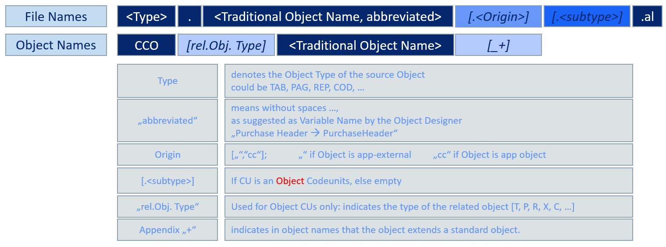
Programming in AL Object Types: Theory and HandsOn - Codeunits
Examples
Object Name Object File Object Folder
Object CU of Table „Item“ „CCO T Item +“ TAB.Item.code.al TAB.Item
Object CU of Page „Item Card“ „CCO P Item Card +“ PAG.ItemCard.code.al PAG.ItemCard
Object CU of „New APP Table“ „CCO T New App Table“ TAB.NewAppTable.code.al TAB.NewAppTab
Object CU of CU 90 „Purch.-Post“ „CCO C Purch.-Post +“ COD.PurchPost.code.al COD.PurchPost
New „App Library“ Codeunit „CCO App Library COD.AppLibrary.al COD.AppLibrary

Slide 76
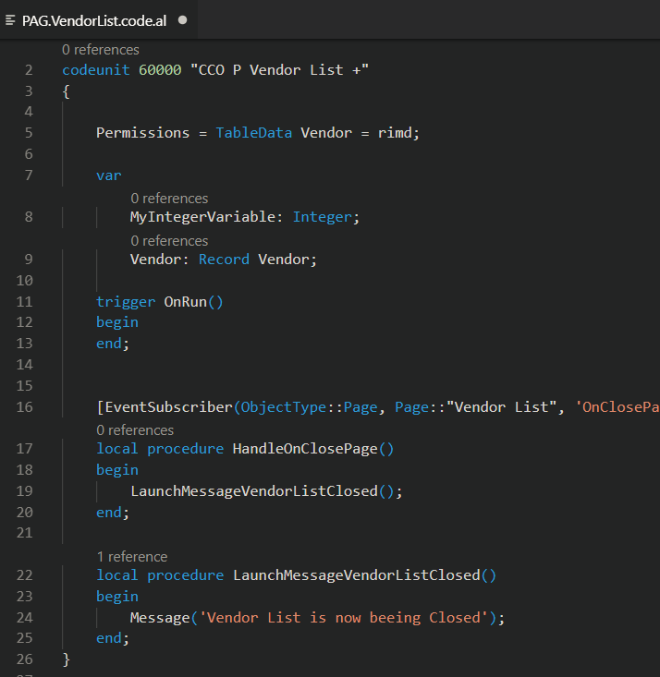
Programming in AL Object Types: Theory and HandsOn - Codeunits
Structure
Codeunit <ID> "<Name>"
{
}
[Properties]
[Variables]
[Triggers]
[Procedures]

Slide 77
Programming in AL Object Types: Theory and HandsOn - Codeunits
Properties
https://docs.microsoft.com/en-us/dynamics365/business-central/dev-itpro/developer/properties/devenv-codeunit-properties
Syntax
<Property> = <Value>;
Use Context IntelliSense to see possible Properties.
Use Context IntelliSense after the "=" to see possible Values.
Example
Permissions = tabledata "Item" = RIMD,
tabledata "Item Ledger Entry" = RIMD;

Slide 78
Programming in AL Object Types: Theory and HandsOn - Codeunits
Variables
Syntax
var
[Attributes]
<Name>:<Definition>
Possible Attributes: „InDataSet“, „RunOnClient“
Use context intelliSense …
Examples
var
Item: Record Item;
ItemNo: Code[20];
[InDataSet]
DescriptionVisible: Boolean;

Slide 79
Programming in AL Object Types: Theory and HandsOn - Codeunits
Procedures
Syntax
[Attributes]
[local] procedure <Name>([Parameters]) [ReturnValue]
[Variables (local)]
begin
[Code]
end;
Use context intelliSense …
[Attributes]
- [IntegrationEvent(<IncludeSender>, <GlobalVarAccess>)]
- [BusinessEvent(<IncludeSender>, <GlobalVarAccess>)]
- [EventSubscriber(ObjectType::<ObjectType>, <ObjectId>, <EventName>, <ElementName>, <SkipOnMissingLicense>, <SkipOnMissingPermission>)]
Use Context IntelliSense to see possible EventNames.
Use Context IntelliSense to see possible ElementNames.

Slide 80
Programming in AL Object Types: Theory and HandsOn - Codeunits
[Parameters]
[var] <Name>: <Definition>
Multiple Parameters separated by semicolon.
Example:
procedure SelectItem(var Item: Record "Item"; DefaultItemNo: Code[20]) Selected: Boolean
[ReturnValue]
[Name]: <Definition>
Multiple Parameters separated by semicolon.
Example:
procedure SelectItem(var Item: Record "Item"; DefaultItemNo: Code[20]) Selected: Boolean
[Variables (local)]
c.f. above

Slide 81
Programming in AL Object Types: Theory and HandsOn - Codeunits
Triggers
Syntax
Trigger <Name>()
[Variables (local)]
begin
[Code]
end;
Use Context IntelliSense to see possible Triggers (<Name>: in the case of Codeunits, its only OnRun)
Always Remember to get detailed insight
If you don‘t know, what to do - 2: Use Txt2AL Converter

Slide 82
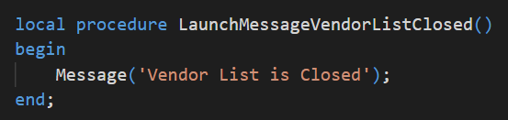
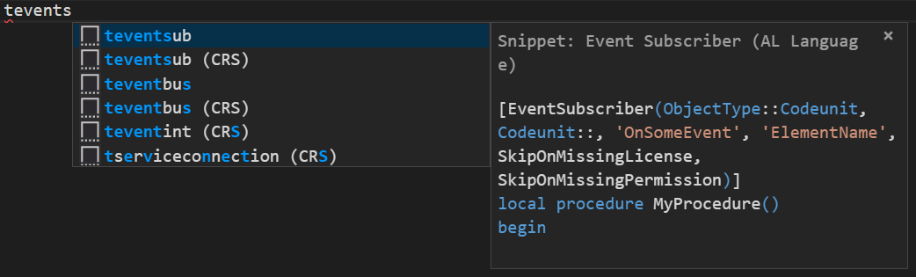
HandsOn
HandsOn – Exercise 8 | Procedures and Snippets
Implement „Message Vendor List is closed“ using Snippets
Open (My first) AL Project
Place cursor in new line (beyond existing Event Subscriber Procedure)
Find and Open Object CU of Vendor List
Type (leading) fragment of „teventsubscriber“ to start intelliSense
Implement new Functionality
Implement the Desired Function „LaunchMessageVendorListClosed“
Choose the right snippet and implement the Event Subscriber
Run and Test the Project

Slide 83
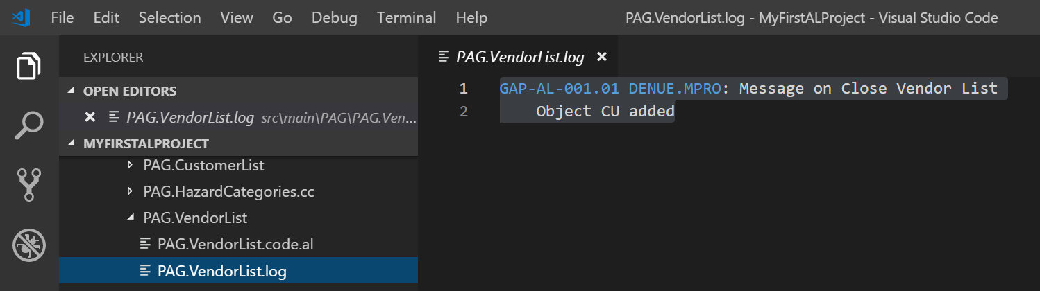
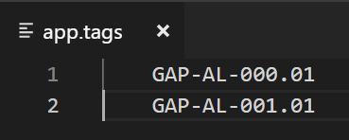
HandsOn
HandsOn – Exercise 9 | Documentation „logs and tags“
Finish „GAP-AL-000“: „Description 3 on Item Card“ and „GAP-AL-001: Message on Close Vendor List “
Open (My first) AL Project
Create Documentation (log-file(s))
Log your GAPs within the „app.tags“-file
Close open Editors and search for the GAP
Run and Test the Project

Slide 84
Programming in AL Object Types: Theory and HandsOn - Pages
https://docs.microsoft.com/en-us/dynamics365/business-central/dev-itpro/developer/devenv-page-object
Snippet „tpage“ (Card, API, List)
Naming
File Names
PAG
.
<Agent Object Name, abbreviated>
.cc
.al
Object Names
CCO
<Agent Object Name>
„abbreviated“
means without spaces …,
as suggested as Variable Name by the Object Designer
„Purchase Header → PurchaseHeader“
Example
Object Name Object File Object Folder
New Page „My new Page“ „CCO My new Page“ „TAB.MyNewPage.cc.al“ „PAG.MyNewPage.cc“
Note that all Page files have a „.cc“ in their names …. all of them are new, always!

Slide 85
Programming in AL Object Types: Theory and HandsOn - Pages
Structure
Page <ID> "<Name>"
{
[Properties]
[Layout]
[Actions]
[Variables]
[Triggers]
[Procedures]
}
If you don‘t know Syntax of [Layout] and [Actions], use Txt2AL Converter (or intelliSense)
Page snippet comes with „empty“ frameworks of pages of certain types, showing both „Layout“ and „Action“ syntax
VS Code Extsnsion „CRS AL Language Extension“ comes with additional page snippets
Integrates page into search functionality
Syntax as before
Special Properties (amongst others)
UsageCategory
https://docs.microsoft.com/en-us/dynamics365/business-central/dev-itpro/developer/properties/devenv-usagecategory-property
https://docs.microsoft.com/en-us/dynamics365/business-central/dev-itpro/developer/devenv-al-menusuite-functionality
AplicationArea
https://docs.microsoft.com/en-us/dynamics365/business-central/dev-itpro/developer/properties/devenv-applicationarea-property
Complex but easy syntax. Use Txt2AL Converter to get more insight
See below and / or Use Txt2AL Converter to get more insight.
Globals of the Page, Syntax as before
Layout Elements:
Group
Label
Field
Repeater
…
Page Triggers, Syntax as before
Syntax as before

Slide 86
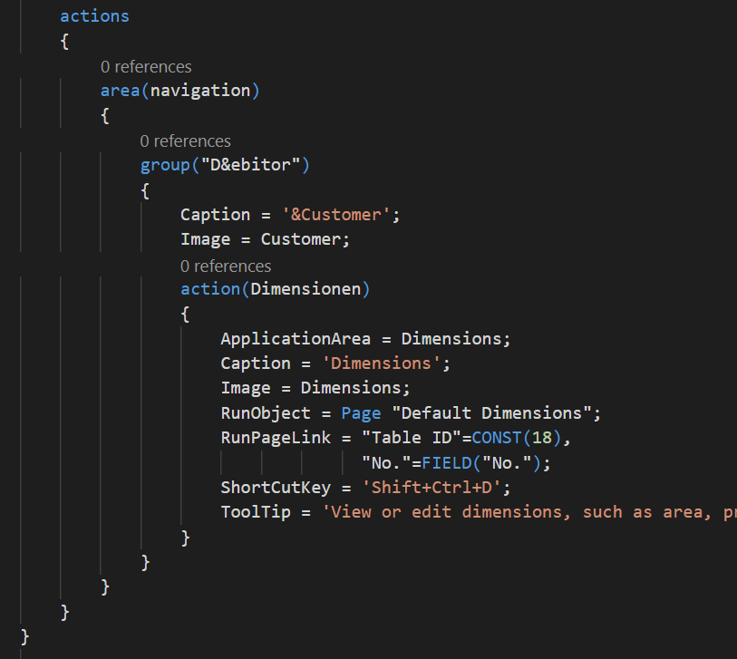
Programming in AL Object Types: Theory and HandsOn - Pages
Actions Syntax
actions
{
area(<area name>)
{
group(<group name>)
{
[Properties]
action(<name>)
{
[Properties]
[Trigger OnAction]
}
[actions]
[groups]
}
[groups]
}
[areas]
}
„Syntax as usual“

Slide 87
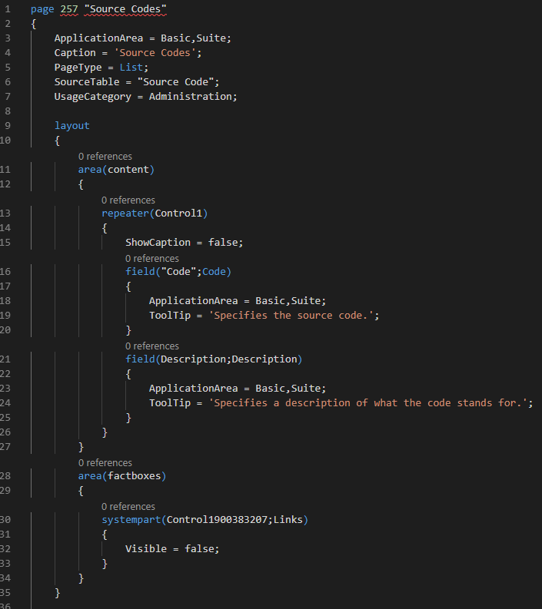
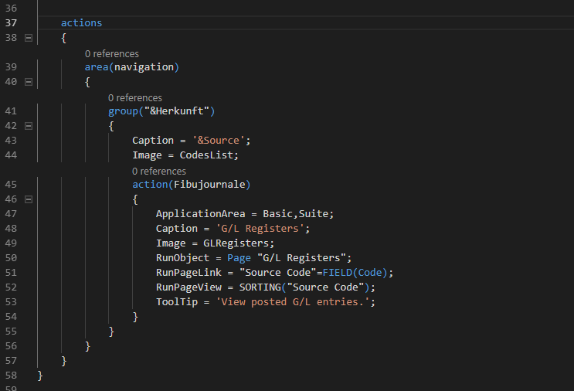
HandsOn
HandsOn – Exercise 9.5 | Pages
Convert a Page of your choice from C/Side to AL and analyze the „Layout“

Slide 88
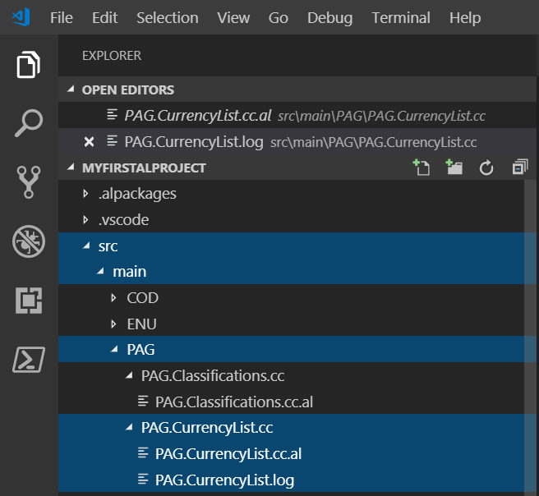
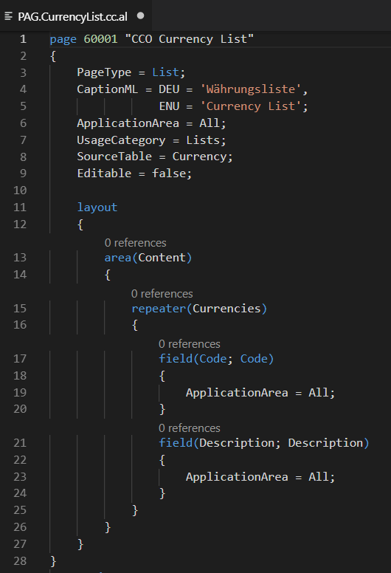

HandsOn
HandsOn – Exercise 10 | Pages
Implement „GAP-AL-002: Currency List“
Create a simple List Page „Currency List“, which shows a list of all Currencies and their Descriptions. It shall not be possible to edit the list. Via an Action „Show extended List“, it shall be possible to open the standard currency list „Currencies“.
Open (My first) AL Project
Create the file structure needed
Implement the page without the action
Verify functionality
Implement the desired action
Run and Test the Project

Slide 89
HandsOn
HandsOn – Exercise 10 | Pages
Implement „GAP-AL-002: Currency List“
Create a simple List Page „Currency List“, which shows a list of all Currencies and their Descriptions. It shall not be possible to edit the list. Via an Action „Show extended List“, it shall be possible to open the standard currency list „Currencies“.
Open (My first) AL Project
Create the file structure needed
Implement the page without the action
Verify functionality
Implement the desired action
Run and Test the Project

Slide 90
HandsOn
HandsOn – Exercise 10 | Pages
Implement „GAP-AL-002: Currency List“
Create a simple List Page „Currency List“, which shows a list of all Currencies and their Descriptions. It shall not be possible to edit the list. Via an Action „Show extended List“, it shall be possible to open the standard currency list „Currencies“.
Open (My first) AL Project
Create the file structure needed
Implement the page without the action
Verify functionality
Implement the desired action
Run and Test the Project

Slide 91
HandsOn
HandsOn – Exercise 10 | Pages
Implement „GAP-AL-002: Currency List“
Create a simple List Page „Currency List“, which shows a list of all Currencies and their Descriptions. It shall not be possible to edit the list. Via an Action „Show extended List“, it shall be possible to open the standard currency list „Currencies“.
Open (My first) AL Project
Create the file structure needed
Implement the page without the action
Verify functionality
Implement the desired action
Run and Test the Project

Slide 92
Programming in AL The Truth about Programming in AL
Don‘t know how to do it in AL?
But: If you know how the Standard does it in C/Side
Always Remember
If you don‘t know, what to do - 2: Use Txt2AL Converter
You could think about scetching the „unknown“ syntax in C/Side yourself and then …
You could even think about implementing the desired functionality in C/Side as a whole and then …

Slide 93

HandsOn
HandsOn – Exercise 11 | Object / File Structure
Implement „GAP-AL-003: Currency List advanced“
Extend the functionality of „GAP-AL-002 in a way that the user is prompted „Do you want to open the standard currency list“ when he hits the „Show extended List“ button.
Open (My first) AL Project
Page: OnAction Trigger
calls Object CU
Table Currency: CCOLaunchExtendedList(HideDialog, …)
calls Object CU
Reimplement the Action
ObjectCU(Page):
- HandleOnActionShowExtendedListTrigger calls
- QueryLaunchExtendedList(…)
calls „Agent“
ObjectCU(Table) : LaunchExtendedList(HideDialog, …)
contains functionality
There might be other ways of carrying out this implementation
Run and Test the Project

Slide 94
Programming in AL Object Types: Theory and HandsOn - Tables
https://docs.microsoft.com/en-us/dynamics365/business-central/dev-itpro/developer/devenv-table-object
Snippet „ttable“
Naming
File Names
TAB
.
<Agent Object Name, abbreviated>
.cc
.al
Object Names
CCO
<Agent Object Name>
„abbreviated“
means without spaces …,
as suggested as Variable Name by the Object Designer
„Purchase Header → PurchaseHeader“
Example
Object Name Object File Object Folder
New Table „My new Table“ „CCO My new Table“ „TAB.MyNewTable.cc.al“ TAB.MyNewTable.cc
Note that all Table files have a „.cc“ in their names …. all of them are new, always!

Slide 95

Programming in AL Object Types: Theory and HandsOn - Tables
Structure
Table <ID> "<Name>"
{
}
[Properties]
[Fields]
c.f. below
[Fieldgroups]
[Keys]
[Keys]
[Variables]
[Triggers]
Syntax as before
[Procedures]
key name: must be prefixed
First key in list is primary key

Slide 96

Programming in AL Object Types: Theory and HandsOn - Tables
Structure
Table <ID> "<Name>"
{
}
[Properties]
[Fields]
[Fieldgroups]
[Properties]
[Keys]
[Triggers]
[Variables]
[Triggers]
[Procedures]
Excercise: TableRelation Syntax

Slide 97

HandsOn
HandsOn – Exercise 11.5 | Table Relations and the Txt2AL converter
Gain insight into the syntax of Table Relations by „Txt2AL Converting“ table 39 „Purchase Line“
Configure Txt2AL COnverter
Convert Table 39 „Purchase Line“
Learn the syntax of „Table Relation Property“

Slide 98


Programming in AL Object Types: Theory and HandsOn - Tables
Structure
Table <ID> "<Name>"
{
}
[Properties]
[Fields]
[Fieldgroups]
[Keys]
[Variables]
[Triggers]
[Procedures]

Slide 99
Programming in AL Object Types: Theory and HandsOn - Tables
Some „special“ properties
ObsoleteState
https://docs.microsoft.com/en-us/dynamics365/business-central/dev-itpro/developer/properties/devenv-obsoletestate-property
Marks whether the table, field, or key is or will become obsolete (deprecated).
ObsoleteReason
„Info field” to inform Developers
https://docs.microsoft.com/en-us/dynamics365/business-central/dev-itpro/developer/properties/devenv-obsoletereason-property
TableType, ExternalName, ExternalSchema, LinkedObject, LinkedInTransaction
«Properties to organize connections to external data sources»
https://docs.microsoft.com/en-us/dynamics365/business-central/dev-itpro/developer/properties/devenv-tabletype-property
https://docs.microsoft.com/en-us/dynamics365/business-central/dev-itpro/developer/properties/devenv-externalname-property
https://docs.microsoft.com/en-us/dynamics365/business-central/dev-itpro/developer/properties/devenv-externalschema-property
https://docs.microsoft.com/en-us/dynamics365/business-central/dev-itpro/developer/properties/devenv-linkedobject-property
https://docs.microsoft.com/en-us/dynamics365/business-central/dev-itpro/developer/properties/devenv-linkedintransaction-property
No | Not obsolete; Default
Pending | Will become obsolete; No Effect on Table and Data
Removed | Is obsolete; No Effect on Table; Data access only in upgrade codeunits, else Runtime Error

Slide 100

HandsOn
HandsOn – Exercise 12 | Module Hazard Category Part 1
FRD
It shall be possible to group Items according to their "Hazard Category". "Hazard Categories" should be freely definable. When an article is purchased via ordering, its "Hazard Category" is to be displayed in the purchasing document and should be changeable there. During the course of item posting, the "Hazard Category" has to be transferred into the "Item Ledger Entries" and, if indicated, into the posted purchase documents.
No other processes are to be respected.
No further details have to be respected concerning, e.g., manipulations of partially posted documents etc..
GAP-AL-004: Hazard Categories
A new Data Structure “Hazard Category” is to be implemented
(Table 60100 “Hazard Category” and List Page 60100 “Hazard Categories”).
Hazard Category
Code Code 20
Description Text 80
It shall not be possible to enter “empty” categories.
The new page shall be accessible via the search functionality.
Open and Setup new AL Project
„Hazard Categories“
Don‘t forget the Documentation
Setup proper File Structure
Don‘t forget to update the „app.tags“
Implement GAP-AL-004
Run and Test the implementation

Slide 101
Programming in AL Object Types: Theory and HandsOn – Table Extensions
https://docs.microsoft.com/en-us/dynamics365/business-central/dev-itpro/developer/devenv-table-object
Snippet „ttableext“
Naming
File Names
TAB
.
<Name of extended Table, abbreviated>
.ext
.al
Object Names
CCO
<Name of extended Table>
+
„abbreviated“
means without spaces …,
as suggested as Variable Name by the Object Designer
„Purchase Header → PurchaseHeader“
Example
Object Name Object File Object Folder
Table Extension of Table „Item“ „CCO Item +“ „TAB.Item.ext.al“ TAB.Item

Slide 102

Programming in AL Object Types: Theory and HandsOn – Table Extensions
Structure
tableextension <ID> <Name> extends <Name of extended Table>
{
}
c.f. Table Elements
Syntax as before
If you don‘t know, what to do - 1: Press „Ctrl+Space“
[Properties]
[Fields]
Use intelliSense to get info on the available „items“
Enter [Property] section and type Ctrl+Space to get info on the Properties you can modify
Enter [Trigger] section and type … to get info on the available trigger to „hook in“.
[Fieldgroups]
[Keys]
[Variables]
Some modifications possible, Field Trigger code can not be changed here.
Use proper events or OnBefore-/OnAfterValidate Triggers … → c.f. below …
[Triggers]
For adding / extending DropDown and / or Brick groups via a „addlast“ command
c.f. https://docs.microsoft.com/en-us/dynamics365/business-central/dev-itpro/developer/devenv-field-groups
[Procedures]
What about the sequence of execution compared to
the corresponding Table Event
the corresponding Database Event
???? → see below
New Trigger coming with Extensions

Slide 103
Programming in AL Object Types: Theory and HandsOn – Table Extensions
Remark 1 - Order of execution: how Table Extension Trigger fits into the picture
"Event / Trigger" | Insert(TRUE) / Rec in DB | INSERT(FALSE) / Rec in DB | MODIFY(TRUE)
OnBefore Event Table | + / - | + / - | +
OnBefore Trigger Extension | + / - | - | +
On Trigger Table | + / - | - | +
OnAfterGlobal Event | + / - | - | +
OnBeforeDatabase Event | + / - | + / - | +
OnAfterDatabase Event | + / - | + / - | +
OnAfter Trigger Extension | + / + | - | +
OnAfter Event Table | + / + | + / + | +

Slide 104

Programming in AL Object Types: Theory and HandsOn – Table Extensions
Remark 2 - On the „List of Properties / Things that could be changed“ on Table Extension level
MS Recommendation
Taken from https://github.com/Microsoft/AL/issues/2459

Slide 105



Programming in AL Object Types: Theory and HandsOn – Table Extensions
Remark 3 - On the „List of Properties / Things that could be modified“ on field level: what intelliSense yields
tableextension <ID> <Name> extends <Name of extended Table>
{
}
(c.f. „Table Elements“ for additional (new) fields)
[Properties]
[Fields]
Field Modifications
[Fieldgroups]
[Keys]
[Variables]
[Triggers]
[Procedures]
Normally, we would change / add field
Trigger behaviour via subscribing the
field events …
instead of using this extension trigger
For the order of execution …
See exercise below

Slide 106
Programming in AL Object Types: Theory and HandsOn – Table Extensions
Remark 4 – Extending keys
Up to today, besides of the primary key fields, a key field list must not contain fields from „outside“ the app!

Slide 107
HandsOn
HandsOn – Exercise 13 | Table Extension (Table) Trigger
Sequence of Execution of table extension field triggers compared to relevant standard triggers and events. Implement an Extension which is suited to show the order of execution of „OnBeforeValidate (Extension Trigger)“, „OnBeforeValidate (Table Field Event)“, „OnValidate (Table Field Trigger)“, „OnAfterValidate (Table Field Event)“ and „OnAfterValidate (Extension Trigger)“, use „Description“ field of „Unit of Measure“ as an example.
Implement a Message-Chain which is suited to show the order of execution.
Scetch of Design
Message from within Validate Trigger of standard Field „Description“
New Message in Validate Trigger of standard Field „Description“
Message from within the field modification Trigger „OnBeforeValidate“
New Table Extension of Table „Unit of Measure“
Field Modification, new OnBefore-/OnAfterValidate Trigger,
containing Messages via suitable Calls to Object CU
Message from within the field modification Trigger „OnAfterValidate“
New MessageLaunch function within the Object CU
Message from within Field Event „OnBeforeValidate“
New Event Subscription, located in the Object CU,
call the MessageLauncher from wthin the subscriber
Message from within Field Event „OnAfterValidate“
AL File Structure

Slide 108

HandsOn
HandsOn – Exercise 13 | AL File Structure

Slide 109
HandsOn
HandsOn – Exercise 13 | Doing
Sequence of Execution of table extension field triggers compared to relevant standard triggers and events. Implement an Extension which is suited to show the order of execution of „OnBeforeValidate (Extension Trigger)“, „OnBeforeValidate (Table Field Event)“, „OnValidate (Table Field Trigger)“, „OnAfterValidate (Table Field Event)“ and „OnAfterValidate (Extension Trigger)“, use „Description“ field of „Unit of Measure“ as an example.
Implement a Message-Chain which is suited to show the order of execution.
Create new AL Project „SomeALTests“
Open VS Code,
press Alt+A Alt+L to create „Hello World“ …
Connect the Project to your DB
Adapt launch.json and app.json
Clean up „Hello World“ …
Implement Field Modification, add OnBefore-/OnAfterValidate Trigger, Implement Messages via suitable Calls to Object CU
Implement the Modification of the Standard
Add Message to the Validation of Description
Implement a MessageLaunch function within the Object CU
Create Extension of Tab 204 „Unit of Measure“
Create proper AL File Structure
Add Subscription of standard Validation Events to the Object CU,
call the MessageLauncher from wthin the subscriber
Implement Extension
Run the Project, gain insight …
Learn
how extension field trigger fit into the total field trigger / event scenario
that invoking intelliSense is always a good idea

Slide 110



HandsOn
HandsOn – Exercise 13 | Hybrid Implementation
!!!

Slide 111
Programming in AL Object Types: Theory and HandsOn – Page Extensions
https://docs.microsoft.com/en-us/dynamics365/business-central/dev-itpro/developer/devenv-page-ext-object
Snippet „tpageextension“
Naming
File Names
PAG
.
<Name of extended Page, abbreviated>
.ext
.al
Object Names
CCO
<Name of extended Page>
+
„abbreviated“
means without spaces …,
as suggested as Variable Name by the Object Designer
„Purchase Header → PurchaseHeader“
Example
Object Name Object File Object Folder
Extension of Page „Item Card“ „CCO Item Card +“ „PAG.ItemCard.ext.al“ „PAG.ItemCard“

Slide 112


Programming in AL Object Types: Theory and HandsOn – Page Extensions
Structure (similar to the structure of pages …)
Pageextension <ID> „<Name>“ extends <Name of extended Page>
{
}
Group
Field
Label
…
<Keyword>(anchor)
{
[layout element 1]
[layout element 2]
[….]
}
[Properties]
[addafter(anchor){list of elements}]
[Layout]
[addbefore (anchor){list of elements}]]
[Actions]
[addfirst (anchor){list of elements}]]
[Variables]
[addlast (anchor){list of elements}]]
[Triggers]
[moveafter(<anchor>, <target>)]
[Procedures]
[movebefore(<anchor>, <target>)]
[movefirst(<anchor>, <target>)]
modify(<control- / actionname>)
{
[Properties]
[Triggers]
}
[movelast(<anchor>, <target>)]
c.f. Table Elements
Syntax as before
[modify(<control / action>)]

Slide 113


HandsOn
HandsOn – Exercise 14 | Page Extension Layout
Create an Item (Card) extension
Item Table: Add a new field „My new Description“ (Text 50)
Item Card
Add a label „Here comes the Item No.“ on first place of fast tab „Item“
Move the „Replenishment System“ from where ever it is at the right bottom of the „Item“ fast tab.
Add a „Description Group“ at the right bottom of the „Item“ fast tab, containing all three Item Descriptions
Rename „Item“ fast tab to „Item Fast Tab“ („Artikelregister“)
Add a new first fast tab „Descriptions“, place all three „Descriptions“ on this fast tab
Add an action to the „Sales“ section of the „Navigate“ menu which launches the currency list.
Open / Create AL Project „SomeALTests“
There might be other ways of carrying out this implementation
Create proper file structure
Add field to „Item Extension“

Slide 114




HandsOn – Exercise 14 | Page Extension Layout, continued 1
HandsOn
Add a label „Here comes the Item No.“ on first place of fast tab „Item“
Check Result
Move the „Relenishment System“ from where ever it is at the right bottom of the „Item“ fast tab.
There might be other ways of carrying out this implementation
Check Result
Add a „Description Group“ at the right bottom of the „Item“ fast tab, containing all three Item Descriptions

Slide 115



HandsOn – Exercise 14 | Page Extension Layout, continued 2
HandsOn
Rename „Item“ fast tab to „Item Fast Tab“ („Artikelregister“)
Check Result
Add a new first fast tab „Descriptions“, place all three „Descriptions“ on this fast tab
There might be other ways of carrying out this implementation
Check Result
Add an action to the „Sales“ section of the „Navigate“ menu which launches the currency list.

Slide 116

HandsOn – Exercise 14 | Page Extension Layout, continued 4
HandsOn
Learn
how to influence the layout of a page
Page extensions are „executed“ from top to bottom … „the last one wins“

Slide 117

HandsOn
HandsOn – Exercise 15 | Module Hazard Category Part 2
FRD
It shall be possible to group Items according to their "Hazard Category". "Hazard Categories" should be freely definable. When an article is purchased via ordering, its "Hazard Category" is to be displayed in the purchasing document and should be changeable there. During the course of item posting, the "Hazard Category" has to be transferred into the "Item Ledger Entries" and, if indicated, into the posted purchase documents.
No other processes are to be respected.
No further details have to be respected concerning, e.g., manipulations of partially posted documents etc..
Remember: New data structure was setup with GAP-AL-004
GAP-AL-005: Hazard Categories – Functionality
Implement new fields in tables “Item”, “Purchase Line”, “Purch. Rcpt. Line”, “Item Journal Line” and “Item Ledger Entry”.
Implement functionality.
Open AL Project „Hazard Categories“
Don‘t forget the Documentation
Setup proper File Structure
Don‘t forget to update the „app.tags“
Implement GAP-AL-005
Run and Test the implementation

Slide 118
HandsOn
HandsOn – Exercise 15 | Module Hazard Category Part 2, continued
Functionality
Involved Objects
Data Structure & GUI
Posting:
Transfer of Hazard Category from Jnl Line to Entry
(via OnAfterInitItemLedgEntry)
New field „Hazard Category Code“ on Fast Tab „Item“
New field „Hazard Category Code“
Posting:
Transfer of „Hazard Category“ from Purchase Line to „Jnl Line“
(via OnAfterCopyItemJnlLineFromPurchLine)
New field „Hazard Category Code“ Code[20]
Preassignment & Consistecy Checks:
- Copy „Hazard Category“ from Item if not yet filled
(via OnAfterAssignItemValues)
- Ensure „Hazard Category“ only present with Items …

Slide 119
Programming in AL Object Types: Theory and HandsOn – Enums
https://docs.microsoft.com/en-us/dynamics365/business-central/dev-itpro/developer/devenv-extensible-enums
Snippet „tenum“
Naming
File Names
ENU
.
<Enum Name, abbreviated>
.cc
.al
Object Names
CCO
<Enum Name>
„abbreviated“
means without spaces …,
as suggested as Variable Name by the Object Designer
„Purchase Header → PurchaseHeader“
Example
Object Name Object File Object Folder
New Enum „My new Enum“ „CCO My new Enum“ „ENU.MyNewEnum.cc.al“ „ENU.MyNewEnum.cc“
Note that all Enum files have a „.cc“ in their names …. all of them are new, always!

Slide 120

Programming in AL Object Types: Theory and HandsOn – Enums
Structure
Enum <ID> „<Name>“
{
}
[Properties]
One Property only: Extensible to rule if particular Enum may be extended
[Values]
Value(<Unique „No.“ of value>; <Unique Enum Value (Name)>)
{
[Properties]
}
Available Properties: Caption and CaptionML (runtime 2.3 and later)

Slide 121
Programming in AL Object Types: Theory and HandsOn – Enums
Table Fields / Variables can be of type „Enum“, subtype „Enum ID“
Enums „replace“ Options
Syntax like Option Syntax
Enum Values are referenced via „<Enum Name>::<Unique Enum Value Name>
Enum Values Names are to be prefixed
More and more Enums will enter the standard, more and more will be extensible
Note that „Extensibility“ here means that any code which „cases“ options must be extensible, too

Slide 122

HandsOn
HandsOn – Exercise 16 | Customer Classification, Enums
GAP-AL-006: Customer Classification
It shall be possible to setup a classification of customers by assigning them one of the „values“ „---“, „Bronze Customer“, „Silver Customer“ or „Gold Customer“. An Action „Suggest Salutation“ in the Customer Action Group shall suggest a salutation depending on the particular classification. The Action starts a respective message „Hello <name>“, „Dear bronze <Name>“, „Dear silver <name>“ or „Dear most revered gold <name>“.
Create new AL Project „CustomerClassification“
Open VS Code,
press Alt+A Alt+L to create „Hello World“ …
Connect the Project to your DB
Adapt launch.json and app.json
Clean up „Hello World“ …
Implement the GAP
Create proper AL File Structure
There might be other ways of carrying out this implementation
Continuation

Slide 123


HandsOn
HandsOn – Exercise 16 | Customer Classification, Enums continued 1
GAP-AL-006: Customer Classification
It shall be possible to setup a classification of customers by assigning them one of the „values“ „---“, „Bronze Customer“, „Silver Customer“ or „Gold Customer“. An Action „Suggest Salutation“ in the Customer Action Group shall suggest a salutation depending on the particular classification. The Action starts a respective message „Hello <name>“, „Dear bronze <Name>“, „Dear silver <name>“ or „Dear most revered gold <name>“.
Implement the GAP
Create proper AL File Structure
Create Enum Object
Create Table Extension of Customer Table with new Classification Field
Show the field on Customer Card
There might be other ways of carrying out this implementation
Add Action functionality
Don‘t forget about Documentation
(logs and tags)
Run / Test the Project
Learn Enum Syntax

Slide 124

HandsOn
HandsOn – Exercise 16 | Customer Classification, Enums continued 2
GAP-AL-006: Customer Classification : Hints
There might be other ways of carrying out this implementation

Slide 125
Programming in AL Object Types: Theory and HandsOn – Enum Extensions
https://docs.microsoft.com/en-us/dynamics365/business-central/dev-itpro/developer/devenv-extensible-enums
Snippet „tenum“
Naming
File Names
ENU
.
<Enum Name, abbreviated>
.ext
.al
Object Names
CCO
<Enum Name>
+
„abbreviated“
means without spaces …,
as suggested as Variable Name by the Object Designer
„Purchase Header → PurchaseHeader“
Example
Object Name Object File Object Folder
New Enum Extension „CCO My Enum Extension +“ „ENU.MyEnumExtension.ext.al“ „ENU.MyEnumExtension“
„My Enum Extension“

Slide 126

Programming in AL Object Types: Theory and HandsOn – Enum Extensions
Structure
enumextension <ID> „<Name>“ extends <Name of extended Enum>
{
}
[Values]
Value(<Unique „No.“ of value>; <Unique Enum Value (Name)>)
{
[Properties]
}
(Available Properties: Caption and CaptionML (runtime 2.3 and later))

Slide 127
Programming in AL Object Types: Theory and HandsOn – Reports
See workshop Microsoft AL [Reports]

Slide 128


Miscellaneous
APP Dependencies
The “CU Launcher”
Debugger
Life Cycle Management
Language Features
… to be added …

Slide 129


Miscellaneous APP Dependencies
It is possible to extend Extensions
Dependencies are configured within the app.json file
Symbols of a additional „root“ app
can be downloaded, if „root“ app is present in the target database
If available as file, they can be copied directly into the „.alpackages“ directory
Sometimes, source code (including symbols) can be downloaded
from productive environment

Slide 130
Miscellaneous APP Dependencies
„Dependency Graph“
Page Customization
Dependent App
App 3
Want to install „modifiction“ of „App 1“
App 1
App 2
Deinstall „Dependent App“ and „Page Customiztion“ first
Base App

Slide 131


HandsOn
HandsOn – Exercise 17 | Extending Customer Classification, Extended Enums
GAP-AL-007: Extended Customer Classification
The Customer Classification system shall be extended by a new category „Platinum Customer“.
The corresponding salutation suggestion shall be „Hallo supreme most revered <name>“
Create new AL Project „CustomerClassificationExtension“
Open VS Code,
press Alt+A Alt+L to create „Hello World“ …
Connect the Project to your DB
Adapt launch.json and app.json
Clean up „Hello World“ …
Define the Dependency via app.json
There might be other ways of carrying out this implementation
Implement the GAP
Create proper AL File Structure
Continuation

Slide 132


HandsOn
HandsOn – Exercise 17 | Extending Customer Classification, Extended Enums
GAP-AL-007: Extended Customer Classification
The Customer Classification system shall be extended by a new category „Platinum Customer“.
The corresponding salutation suggestion shall be „Hallo supreme most revered <name>“
Implement the GAP
Create proper AL File Structure
Implement Enum Extension
Implement Extension of Salutation Suggestion
There might be other ways of carrying out this implementation
Run / Test the Project

Slide 133
Miscellaneous
APP Dependencies
The “CU Launcher”
Debugger
Life Cycle Management
Language Features
… to be added …

Slide 134
HandsOn
HandsOn – Exercise 18 | Tools: CU Launcher
GAP-AL-008: CU Launcher
A functionality is to be implemented, which allows to start particular codeunits via GUI.
Design
Page „CU Launcher“
with control „CU ID to launch“
Action „Launch CU“ which launches CU (after proper confirmation)
Create / Open AL Project „SomeALTests“
Open VS Code,
press Alt+A Alt+L to create „Hello World“ …
Connect the Project to your DB
Adapt launch.json and app.json
Clean up „Hello World“ …
There might be other ways of carrying out this implementation
Implement the GAP
Create proper AL File Structure
Create a Codeunit
(?? in another APP ??)
suited to test the functionality
….
Create functionality
Run / Test the Project
Learn: Objects can be „cross-app“ adressed by ID

Slide 135
Miscellaneous
APP Dependencies
The “CU Launcher”
Debugger
Life Cycle Management
Language Features
… to be added …

Slide 136

Miscellaneous Debugging
Available „OnPremise“ and within docker sandbox containers of cloud systems (…)
not yet really available on cloud sandbox systems (nor on cloud production systems)
Hit F9 in VS Code to define Breakpoins, F5 to start debugging
Launch.json setting: „breakOnError“, „breakOnRecordWrite“
Remark

Slide 137
Miscellaneous
APP Dependencies
The “CU Launcher”
Debugger
Life Cycle Management
Language Features
… to be added …

Slide 138
Miscellaneous Life Cycle Management
Installing, Upgrading, …
To be dealt with in a separate workshop (07-Microsoft-AL-Application-Lifecycle)
https://docs.microsoft.com/en-us/dynamics365/business-central/dev-itpro/developer/devenv-app-life-cycle

Slide 139
Miscellaneous
APP Dependencies
The “CU Launcher”
Debugger
Life Cycle Management
Language Features
… to be added …

Slide 140
Miscellaneous Language Features
For complete list, see https://docs.microsoft.com/en-us/dynamics365/business-central/dev-itpro/developer/methods-auto/library
Examples
List Data Type
provides arranged list of elements of „simple data type“
Example: MyTextList: List of [Text]
„Array-like“ but not „bound by declaration“
Comes with bunch of methods to manipulate lists
Text Builder Data Type
“Wrapper” for the .Net implementation of StringBuilder.
Json-”…” Data Types
JsonArray, JsonObject, JsonToken, JsonValue
Come with bunch of methods to handle / manipulate Json files
„Lots of“ Xml-”…” Data Types
Come with bunch of methods concerning xml handling

Slide 141
Miscellaneous
APP Dependencies
The “CU Launcher”
Debugger
Life Cycle Management
Language Features
… to be added …

Slide 142
Miscellaneous
APP Dependencies
The “CU Launcher”
Debugger
Life Cycle Management
Language Features
… to be added …

Slide 143

Miscellaneous …to be added …
Notes on
Permission Sets

Slide 144
Miscellaneous …to be added … | continued
Notes on
DataType „Dictionary“
https://docs.microsoft.com/en-us/dynamics365/business-central/dev-itpro/developer/methods-auto/dictionary/dictionary-data-type
Procedure Overload
https://docs.microsoft.com/en-us/dynamics365/business-central/dev-itpro/developer/methods/devenv-overload-method
HowTo handle xliffs
https://docs.microsoft.com/en-us/dynamics365/business-central/dev-itpro/developer/devenv-work-with-translation-files
Store in „agent folder“, „to be automatically collected in central folder before starting the build process“
HowTo handle layouts
https://docs.microsoft.com/en-us/dynamics365/business-central/dev-itpro/developer/devenv-howto-rdl-report-layout
Store in „agent folder“, „to be automatically copied to central folder before starting the build process“

Slide 145

Miscellaneous Code Runner in “Test” Apps

Slide 146



Q & A
AL
Getting Started with AL
Competence Team DevTech
Channel Microsoft AL

